Slide 1
Key Moments in NADCP History
A Deeper Dive into Effective Behavior Modification for High-Risk & High-Need Persons
Douglas B. Marlowe, J.D., Ph.D.

Slide 2
Key Moments in NADCP History
Outline
Neuroscience overview of “risk” & “need”
The higher the risk & need levels, the less room for error
Goal classification
Classifying the difficulty level of goals should be the first order of business before considering a response
Input from treatment and supervision officers is critical
Choosing effective responses and
avoiding negative side-effects
Behavioral case-planning & responsivity
Setting goals in the correct sequence
Response delivery
Delivering responses in the correct order and manner

Slide 3
Brain Development 101
The brain develops from the inside out, and from back to front:
Continues through ~ 25 years of age on average
Critical periods reflect accelerated development in some regions
Branching and pruning of connections
Myelination (insulation) of nerve fiber axons
White matter connections
Behavioral and health risks are greatest during critical periods, especially when different brain regions are unevenly developed
Greatest unevenness between motivational impulses and executive control is during adolescence (highest critical risk period)
Autonomic
(e.g., breathing)
Motoric
Sensorimotor
integration
Executive
control
Sensory
(e.g., sight,
touch, sound)
Learning &
memory
Motivational
Processes:
goal seeking;
risk taking; independence
Abstraction

Slide 4
Adolescent Vulnerability
Limbic region developed faster and greater than frontal region (motivational processes > executive reasoning)
Risk taking, experimentation, independence, mate seeking
(> judgment, insight, and forethought)
UPSHOT #1: Addiction is often an adolescent-onset disorder
Sensitivity of limbic region leads to rapid tolerance
Neurotoxicity from drugs and trauma causes more diffuse, chronic, and pervasive impairments during critical periods
Psychosocial stressors (e.g., peer rejection, school problems, trauma, divorce) release cortisol, exacerbating neurotoxic effects
UPSHOT #2: The pernicious effects of substance use, stress, and trauma on the brain are far more serious and enduring for adolescents

Slide 5
Cannabis
Cannabinoid receptors are dense in limbic regions undergoing rapid development in adolescence
interferes with synaptic refinement and myelination
diffuse cognitive deficits including attention, motivation, inhibitory control over wrong responses, visuospatial and verbal skills, processing speed, and IQ scores
effects directly proportional to age of onset, frequency, potency, and duration of usage
Interferes with conduction and coordination across the corpus callosum connecting the brain hemispheres
40% increased risk of psychotic disorders; 25% increase in Schizophrenia among young males (also increased risk of Bipolar Disorder, PTSD, anxiety, and depression)
THC potency increased 14 - 80 times in past 3 decades
CBD, which attenuates THC, has declined in-step

Slide 6
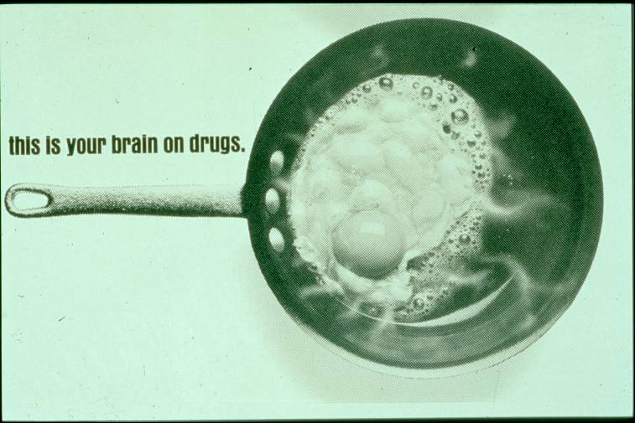
Your Brain on Drugs . . . then

Slide 7
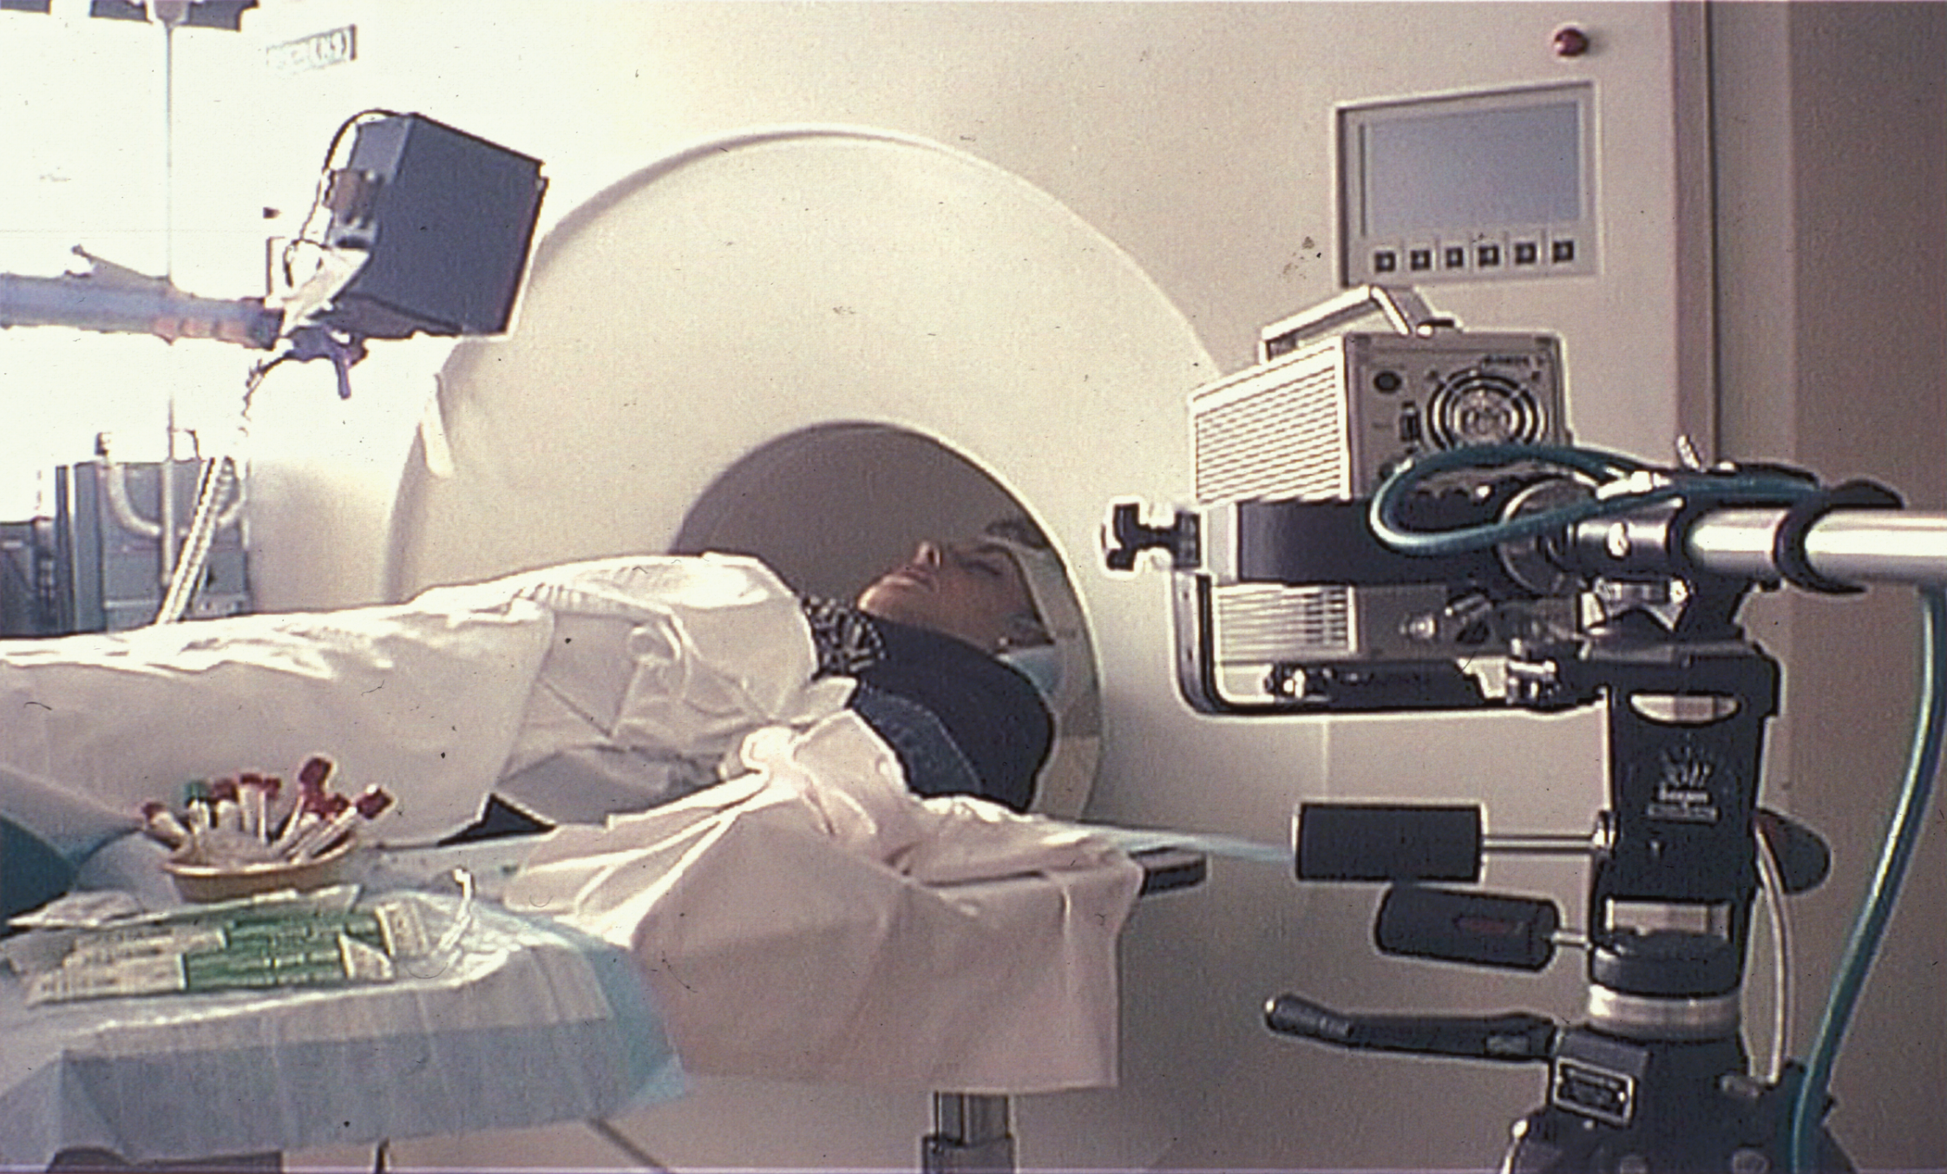
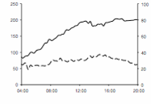
Your Brain on Drugs . . . now
Infusion Rate
VAS

Slide 8
Your Brain on Drugs – Now
Source: Breiter & Rosen, Ann N Y Acad Sci 1999

Slide 9
Natural Rewards Elevate Dopamine
FOOD
SEX
200
200
NAc shell
150
150
DA Concentration (% Baseline)
100
100
15
% of Basal DA Output
Empty
10
50
Copulation Frequency
Box
Feeding
5
0
0
0
60
120
180
Time (min)
Female 1 Present
Female 2 Present
1
2
3
4
5
6
7
8
9
10
11
12
13
14
15
16
17
Mounts
Intromissions
Ejaculations
Source: Di Chiara et al.
Source: Fiorino and Phillips

Slide 10
Drugs Elevate Dopamine MORE
AMPHETAMINE
COCAINE
1100
1000
400
900
800
DA
300
DA
700
DOPAC
% of Basal Release
DOPAC
HVA
600
HVA
% of Basal Release
500
200
400
300
200
100
100
0
0
0
1
2
3
4
5 hr
0
1
2
3
4
5 hr
Time After Amphetamine
Time After Cocaine
250
NICOTINE
MORPHINE
250
Dose (mg/kg)
200
Accumbens
200
0.5
% of Basal Release
Caudate
1.0
150
% of Basal Release
2.5
150
10
100
100
0
0
0
1
2
3 hr
0
1
2
3
4
5hr
Time After Nicotine
Time After Morphine

Slide 11
Compulsivity & Craving

Slide 12
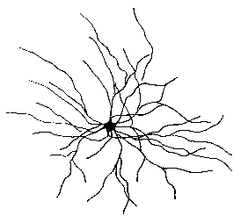
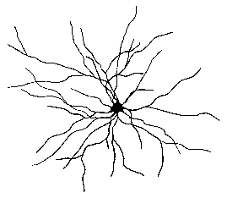
Cravings and Preoccupation
Chronic cocaine use increases density of dendritic spines and neuronal branching in the nucleus accumbens and amygdala
11
60
10
55
Branches
COC
9
50
45
CTL
8
CTL COC
CTL COC
CTL COC
Robinson, T.E. & Kolb, B. Eur. J. of Neuro. 1999.
Ferrario, C.R. et al. Biol. Psychiatry, 2005.
The adolescent brain is more
predisposed for “branching”
Notes:
In fact research conducted by Terry Robinson shows that that repeated exposure to cocaine in rats leads to increased number of dendritic spine in the nucleus accumbens neurons and increased in dendritic branching.
Taken together this research shows that repeated exposure to drugs of abuse cause a cascade of events involving increased gene transcription in regions such as the nucleus accumbens that is believed to be responsible for changes in dendrites and synaptic connections leading to drug addiction.

Slide 13
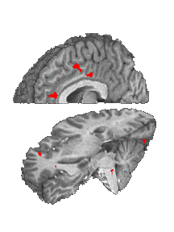
Pavlovian Conditioning
Watching a cocaine film
Cingulate
Ant Cing
Signal Intensity (AU)
Amygdala attaches
affective valence to
drug-related stimuli
(people, places, things)
Cocaine Film
IFG
Controls Cocaine Abusers
Garavan et al A .J. Psych 2000

Slide 14
Pavlovian Conditioning
Watching an erotic film
Cingulate
Loss of salience (less
dopamine) for normal activities – must reward healthy activities
Ant Cing
Signal Intensity (AU)
IFG
Controls Cocaine Users
Garavan et al A .J. Psych 2000
Notes:
Garavan et al A .J. Psych 2000

Slide 15
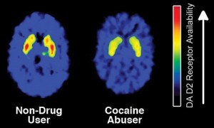
Key Moments in NADCP History
Tolerance
Develops faster in adolescence
Anhedonia
“bored” - “depressed” - “tired” - “just don’t care”
- “don’t know how I feel”

Slide 16
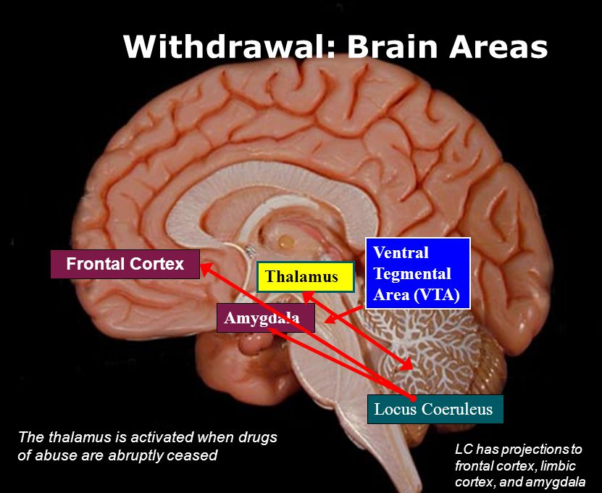
Key Moments in NADCP History
Withdrawal
Negative Reinforcement
Cortisol

Slide 17
Impulsivity & Disinhibition

Slide 18
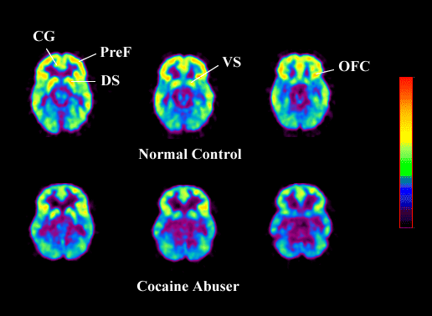
Impulsivity and Disinhibition
(Frontal Brain Glucose Metabolism)
CG
The adolescent prefrontal cortex is
not yet fully developed to begin with!
Disinhibition!

Slide 19
Recovery of Function

Slide 20
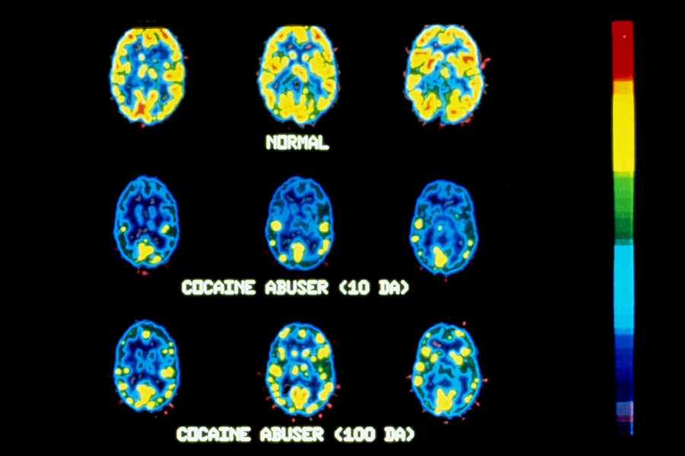
Normal
Cocaine Abuser (10 Days)
Early Remission
Cocaine Abuser (100 Days)
Sources: Volkow, et al., Synapse, 11:184-190, 1992 & Volkow, et al., Synapse, 14:169-177, 1993
Notes:
Sources: Volkow, et al., Synapse, 11:184-190, 1992
& Volkow, et al., Synapse, 14:169-177, 1993

Slide 21
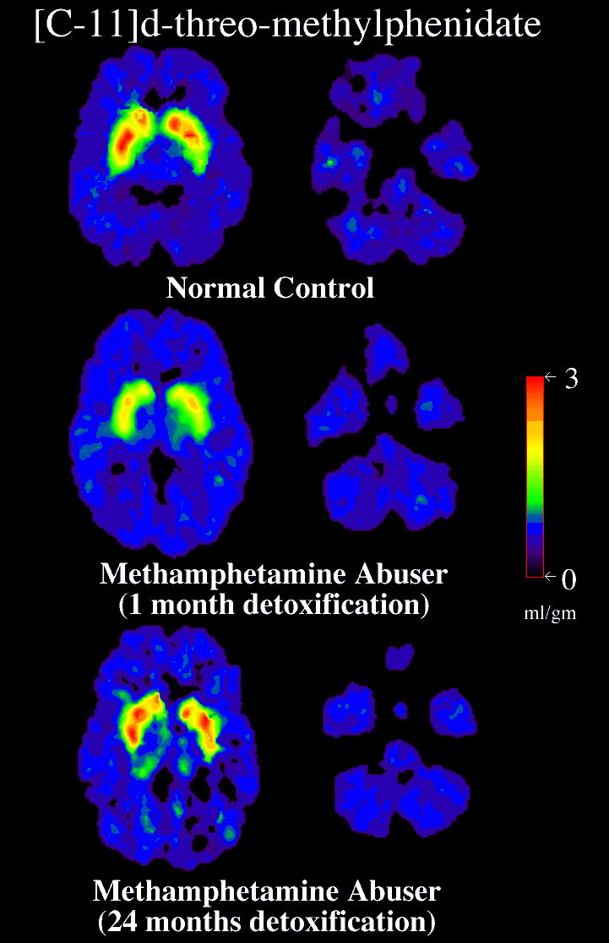
Normal Control
Recovery
with prolonged
abstinence from
methamphetamine
Methamphetamine Abuser
(1 month detoxification)
Sustained Remission
(early recovery)
Methamphetamine Abuser
(14 month abstinent)
Source: Volkow, N.D. et al., Journal of Neuroscience, 21(23), pp. 9414-9418, December 1, 2001.
Notes:
Figure 1. Brain images of the distribution volume of [11C]d-threo-methylphenidate in a control and a METH abuser. Images shown were obtained at the level of the striatum (images to the left) and the cerebellum (images to the right), and they are from a normal control and a METH abuser evaluated twice, during short and protracted abstinence. Notice the significant increases in binding in striatum in the METH abuser with protracted abstinence.

Slide 22
Key Moments in NADCP History
High-Risk Factors
Complicated prognosis or lesser amenability to treatment (not necessarily dangerousness)
younger current age
earlier onset of delinquency or substance use
family history of crime or addiction
antisocial peer groups
antisocial attitudes
impulsivity or executive dysfunction
deficient problem-solving or adaptive life skills
extensive criminal record
previous incarceration

Slide 23
Key Moments in NADCP History
High-Risk Factors
Complicated prognosis or lesser amenability to treatment (not necessarily dangerousness)
younger current age
earlier onset of delinquency or substance use
family history of crime or addiction
antisocial peer groups
antisocial attitudes
impulsivity or executive dysfunction
deficient problem-solving or adaptive life skills
extensive criminal record
previous incarceration

Slide 24
Key Moments in NADCP History
High-Need Factors
Chronic or compulsive substance use disorder with “core” or causal symptoms:
Withdrawal symptoms
Persistent or prolonged cravings
Persistent desire or inability to stop or reduce use
Loss of control over use (“binge” use)
Serious and persistent mental health or trauma disorder
Other chronic and severe treatment needs (e.g., TBI, compulsive gambling)

Slide 25
Shaping Behavior
Treat symptoms, sanction avoidable misconduct, and
reward achievements
Don’t expect too much
Learned helplessness, ratio burden, and ceiling effects
Don’t expect too little
Habituation, complacency
Proximal vs. distal vs. managed goals
Phase advancement (specific responsivity)
What was once distal becomes proximal, and is eventually managed (alter expectations and consequences accordingly)
— and never confuse them!

Slide 26
Key Moments in NADCP History
Classifying Goals
Proximal goals are achievable and sustainable although may not be accustomed or motivated to meeting them
Not necessarily easy but can sustain with reasonable effort
Copious low-magnitude incentives until managed, then thin
Higher-magnitude sanctions for proximal infractions
Distal goals are too difficult to accomplish currently or can only accomplish intermittently or for a limited time
Service adjustments until become proximal
Managed goals have been met and sustained for a reasonable time
Do not need to be performed perfectly but have demonstrated they can meet the expectation
Thin incentives and move on to the next goal
Intermittently incentivize (especially praise) maintenance

Slide 27
Key Moments in NADCP History
Progress Benchmarks
Psychosocial Stability – when attendance, verbal participation, honesty, and prosocial routine have become proximal, and can begin imposing sanctions
required prior to reducing probation sessions, home visits, or court hearings (not yet treatment or drug testing)
Early Remission – when abstinence and problem-solving skills have become proximal
can begin reducing treatment and drug testing
Sustained Remission – when abstinence and problem-solving skills are managed and adaptive life skills (e.g., employment, household management) have become proximal
Recovery Management – when adaptive life skills are managed and recovery is proximal

Slide 28
Key Moments in NADCP History
Psychosocial Stability
The first order of business in the recovery process for high-risk and high-need persons
Required for attendance, participation, prosocial routine, & honesty to be proximal, and prior to reducing probation sessions, home visits, court hearings (not yet treatment or drug testing)
Psychosocial stability:
Secure housing— safe and stable housing for reasonable future
Reliable attendance— ability to attend services reliably, not perfection
Clinical stability— no longer experiencing debilitating symptoms that interfere with other services (e.g., withdrawal, craving, anhedonia, executive dysfunction)
Therapeutic alliance with staff—at least one staff member with whom they can share thoughts, feelings, experiences, and acknowledge concerns and ask for help

Slide 29
Key Moments in NADCP History
Early Remission
The second order of business in the recovery process
Required for abstinence and problem-solving skills to be proximal
Required prior to reducing treatment or drug testing for persons with a compulsive substance use disorder
MAT will often be required and should be unhindered
Early remission:
Compulsive substance use disorder:
≥ 90 days without clinical symptoms (e.g., withdrawal, cravings, anhedonia)
Up to 180 days for youthful onset, prolonged use, or highly neurotoxic substances (e.g., methamphetamine, fentanyl)
Affective disorder (e.g., bipolar disorder, major depression)
≥ 60 days without affective symptoms
Clinical judgment required for other participants (e.g., psychosis, PTSD)

Slide 30
Key Moments in NADCP History
Sustained Remission
The third order of business in the recovery process
When abstinence and problem-solving skills are managed and adaptive life skills are proximal
Compulsive substance use disorder:
≥ 12 months without symptoms, + sustainable abstinence (~ 90 days)
Continue intermittent incentives (especially praise) for maintenance at least until sustained remission is achieved
Recovery management (the fourth order of business)— when adaptive life skills are managed and recovery is achievable (indefinite alteration of a person’s self-identity, values, and lifestyle, with continuous engagement in prosocial activities and recovery community)

Slide 31
Key Moments in NADCP History
Service Adjustments
Service adjustments, not sanctions, for distal infractions
Predicated on recommendations from treatment professionals and supervision officers
Supervision reductions only after psychosocial stability
Treatment reductions only after early remission
If compliant with treatment but not responding, then the problem is with the treatment, not the person — adjust the treatment
If needed treatment is unavailable, then no sanctions or harsher disposition — clarify permissible responses
Learning assignments are service adjustments, not sanctions (e.g., activity log, CBT exercise, journaling, life skills assignment, useful community service)

Slide 32
Key Moments in NADCP History
Incentives
Most important for reinforcement-starved persons (i.e., high-risk and high-need persons)
Activities that compete with undesired behaviors and naturally incentivize recovery (increase dopamine for non-salient activities)
Certainty and celerity are critical, magnitude is not
Verbal praise for all appointments in first phase (4:1 ratio), then thin for maintenance thereafter
Also, public recognition, symbolic tokens, point systems, tangible prizes, fishbowl drawing
Praise maintenance of abstinence for at least one year
Positive reinforcement > negative reinforcement until psychosocial stability
Begin by reducing financial conditions, curfews, home detention, travel restrictions (which often do not improve outcomes)

Slide 33
Key Moments in NADCP History
Sanctions
Technical challenges and side effects if applied to distal infractions include but are not limited to:
Learned helplessness
Ratio burden
Ceiling effects
Transitory effects
Goldilocks effect
Doesn’t teach what to do
Side effects of response-cost sanctions include:
Demoralization
Perfectionism (e.g., “clean time”)
Abstinence violation effect (A.V.E.)
Snow balling (e.g., fines, learning assignments)

Slide 34
Key Moments in NADCP History
Jail Sanctions
Jail has many negative side effects, especially for high-need persons
Not in first 30 - 60 days or first phase
After ~ 4 - 5 lower-magnitude sanctions have been unsuccessful for repeated proximal infractions
No more than 3 to 7 days
Not for distal infractions
Not for treatment
Not to deter drug overdose or for preventive detention
Possible exception: Clear and convincing evidence that restrictive consequence is necessary to prevent serious and imminent harm to the participant or public safety and no less restrictive alternative is available or reasonably likely to be adequate

Slide 35
Key Moments in NADCP History
Proximal Infractions
Weak sanctions for proximal infractions lead to habituation, which worsens outcomes
Higher-magnitude sanctions most effective (e.g., Azrin & Holz, 1966; Martin & Pear, 2019; Skinner 1953; Van Houten, 1983)
Jail sanctions for high-risk (but not high-need) persons (e.g., Hawken & Kleiman, 2009; Kilmer et al., 2012; Nicosia et al., 2023)
Verbal warnings (first ~ 1 or 2) – no shaming or fear!
Moderate magnitude sanctions (next ~ 1 - 2)
e.g., increased supervision, day reporting, court observation, curfew, travel or association restrictions
Higher magnitude sanctions
e.g., home detention, team roundtable, jail detention (< 3-7 days, with least disruption possible)
Possible exception: Clear and convincing evidence that restrictive consequence is necessary to prevent serious and imminent harm to participant or public safety and no less restrictive alternative is available

Slide 36
Key Moments in NADCP History
Distal Infractions
Service adjustments until proximal
Treatment and/or supervision professionals determine when distal goals have become proximal
Abstinence becomes proximal after early remission:
No debilitating symptoms (withdrawal, cravings, anhedonia, executive dysfunction, mental health or cognitive symptoms)
Broad guideline: 3 to 6 months
Periodic reevaluation for reemergence of symptoms, stressors, or associated cue reactions
MAT will often be required and should be unhindered!
Possible exception: Clear and convincing evidence that restrictive consequence is necessary to prevent serious and imminent harm to participant or public safety and no less restrictive alternative is available or reasonably likely to be adequate

Slide 37
Key Moments in NADCP History
Managed Goal Infractions
Terms like relapse, setback, or regression apply only to managed goal infractions
Should be taken seriously but do not overreact
Often occur when services are reduced, after a phase advancement, or when approaching discharge
Determine reason(s) for the infraction before response:
Insufficient preparation – service adjustment; withhold sanctions; no demotion
“Pink cloud” – counseling advice, learning assignment
Symptom recurrence – service adjustment; withhold sanctions; no demotion
Testing the limits – warning and moderate sanction, followed by higher-magnitude sanctions; withhold advancement or completion until back on course

Slide 38
Behavioral Case Planning
Responsivity needs — interfere with rehabilitation (e.g., mental health symptoms, homelessness, withdrawal)
Managed when have achieved psychosocial stability
Criminogenic needs — cause or exacerbate crime (e.g., addiction, antisocial peers, antisocial attitudes)
Managed when achieved early remission, completed CBT problem-solving curriculum (e.g., MRT, T4C), and practicing the skills
Maintenance needs — degrade rehabilitation gains (e.g., illiteracy, deficient job or household management skills)
Managed when completed adaptive skills training (e.g., parenting, household management, vocational training, remedial education)
Recovery management and restorative justice needs — aid in community reintegration and recovery maintenance (e.g., peer specialists, support groups, victim restitution, community service)
Managed when completed achievable restorative justice requirement and engaged in recovery community or activities

Slide 39
Key Moments in NADCP History
Phase Advancement
Managed previously proximal goals, and some distal goals have now become proximal (not time!)
Psychosocial stability & prosocial routine (advance when responsivity needs managed)
Early remission & problem-solving skills (advance when criminogenic needs managed)
Sustained remission & adaptive life skills (advance when maintenance needs managed)
Recovery management (advance when restorative justice and recovery management needs managed)
Copiously praise and celebrate in group setting
Low risk and/or need will not require all phases

Slide 40
Key Moments in NADCP History
Advance Notice
Rule-governed learning
Vicarious learning (status hearings)
Predictability of responses (to avoid learned helplessness)
Phase-specific response guidelines
Team discretion – reasoning for departures
Behavior – not attitude, symptoms, or character

Slide 41
Key Moments in NADCP History
Delivering Responses
Procedural fairness (voice, neutrality, rationale, & therapeutic motive)
Order of attention:
Achievements come first
Exigencies (unusual for and not initiated by participant)
Managed goal infractions
Proximal goal infractions
Distal goal infractions come last
Therapeutic motive and optimism for success are the last messages they hear from us (recency effect) . . .

Slide 42
Key Moments in NADCP History
Key Takeaways
Risk and need largely reflect brain development and the psychosocial sequelae of brain functioning
The higher the risk and/or need levels, the less room there is for error in behavioral techniques
Goal classification is critical before responding
High certainty and celerity (not magnitude) of incentives for achievements, then thin for maintenance (increase dopamine)
Service adjustments, not sanctions, for proximal infractions
Attendance, participation, prosocial routine, and honesty are proximal after psychosocial stability
Abstinence and problem-solving skills are proximal after early remission

Slide 43
Key Moments in NADCP History
Key Takeaways (cont.)
Adaptive life skills are proximal after sustained remission
Recovery is proximal after engaged in recovery-supportive community and activities
Phase advancement marks attainment of these benchmarks and provides opportunity for increased reinforcement and vicarious learning
Address needs in the correct order: 1. responsivity, 2. criminogenic, 3. maintenance, and 4. recovery management
Address conduct and explain your reasoning and responses accordingly
Provide procedural fairness (advance notice, voice, rationale, therapeutic motive, and optimism)

