Slide 1
Understanding the Eviction Process

Slide 2
Panel Discussion
Panel members:
Judge John Stenger, Rio Grande County Court Judge
Benjamin Pacyga, Private Attorney
Chad Keizer, Staff Attorney, Colorado Legal Services
Roxy Gehring, Center for Restorative Programs
Sean Weiland, Director of Crisis Prevention, La Puente
Facilitated by Ronnie Mondragon
12th Judicial District Research Attorney

Slide 3
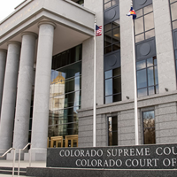
Why are we here?
Access to Justice Committee
Educate community members about court processes and provide resources for better access to the courts
Important for tenant, landlord, and court that landlords understand how to proceed with an eviction correctly and understand and respect tenants’ rights in the process
Less confusion = less conflict

Slide 4
What to expect from this presentation:
General overview of how the eviction process works with emphasis on recent changes.
Conditions residences must be kept in
Rental Assistance
Local resources/mediation program
Panel discussion
NOT COVERED: Special rules for evictions in a mobile home park; foreclosure evictions; collection of a money judgment; appeals

Slide 5
New Laws about Rental Applications
When the landlord is searching for a new tenant, the landlord can require proof of income, but:
The Landlord cannot require that the tenant have income above 200% of monthly rent.

Slide 6
Before you begin… know your lease agreement!
Lease agreement does not necessarily have to be written to be enforceable, but it is preferable because it will make the terms clear for the landlord, tenant, and court, if necessary
Lease agreement should contain information/terms including:
Term/duration of lease
Type and length of notice required to terminate the tenancy
What actions will constitute a violation of the lease and what happens when such a violation occurs

Slide 7
What cannot be in leases?
A “penalty” for the landlord having to evict or a “penalty” for a tenant moving out early.
Security deposits in excess of 2x monthly rent.
A clause that gives attorney’s fees to only one side.
Other prohibited waivers of tenant’s rights

Slide 8
What must be in leases?
For landlords with more than five rental units, there must be a provision in the lease that prohibits “source of income discrimination”.

Slide 9
Resources for Eviction and Foreclosure Prevention
DOLA Emergency Rental Assistance
https//cdola.Colorado.gov/office-of-homeless-initiatives
Requires a Court Summons
Need ID, lease, ledger, proof of income, and client narrative
2-1-1
https://search.211colorado.org
Assistance Finding Food
Paying House Bills
Accessing Free Childcare
Other Essential Services
La Puente Home, Inc.
www.lapuentehome.org
(719)589-5909
Requires an Eviction Notice/Demand
Need ID, lease, ledger, proof of income, and client narrative

Slide 10
Resources for Eviction and Foreclosure Prevention (Continued)
SLV Pro Bono
Free Consultation
Colorado Legal Services
Provides Legal Assistance to Low-Income Individuals
Legal Help with Eviction
slvprobono1@hotmail.com
(719)589-6534
https://www.coloradolegalservices.org/
Holds Free Monthly Clinics (844)404-7400
(719)589-4993
3rd Wednesday of the Month
Community Economic Defense Project
Fighting Evictions and Homelessness in Colorado
Legal Help for evictions
https://cedproject.org
Colorado Poverty Law Project
Matching Low-Income Coloradans with Volunteer Attorneys
https://www.copvertylawproject.org
Holds Monthly Clinics Regarding Eviction and Housing Concerns

Slide 11
Resources for Eviction and Foreclosure Prevention (Continued)
Center for Self-Reliance
Assists Elderly, and Disabled
Brothers Redevelopment
Elderly, Low-Income, and Disabled Housing Solutions
SLV@ILCPUEBLO.ORG
(719)289-0789
ehap@brothersredevelopment.org
(844)926-6632
The Salvation Army
Food Assistance, Utility Assistance, Connection Center
westernusa.salvationarmy.org/intermountain_us_west/covid-19-get-help/
(855)768-7977
Colorado Resource Network
Connecting Community and Legal Resources
www.coloradoresourcenetwork.com
Renters Avenue
https://www.rentersavenue.com/
Self-Help Assistance
Lisa Mizell
(719)589-7621
12selfhelp@judicial.state.so.us
If you don’t know where to start, you can always call the Eviction Hotline at (719) 301-5466
Free Mediation services are available, and in some counties are court ordered. You can set up mediation at any time during the process by calling (719)480-8728

Slide 12
Free Mediation Services Center for Restorative Programs
Referrals:
Call CRP Directly
From the Court
From La Puente
Those in needs of assistance are assigned a caseworker to help with rental assistance and other resources.
Process:
Both Landlord and Tenant to contact CRP
CRP will hear from each side individually
CRP schedule a time to meet for mediation
Outcomes:
Successful mediation: we send the agreement to court
Agreement not reached: we let the court know the parties attempted mediation and opted to go through court instead
Mediation not reached: if one party can’t be contacted, mediation not possible.

Slide 13
“FOR CAUSE” EVICTION POLICY
In general, landlords now must have a reason before they can end a tenancy. If the For Cause Eviction Policy applies, a landlord cannot refuse to renew a tenancy or end a lease unless they have a reason to do so.
Enacted on April 19, 2024.

Slide 14
Who does the “For Cause” protections apply to?
Short-term rentals (such as Airbnbs): Rental for less than 30 days for “temporary, recreational, business, or transient purposes”
Owner-occupied or master-tenant occupied primary residences that are a single-family home, duplex, or triplex
Owner occupied includes where the owner lives on the same lot and must be the owner’s “primary residence.”
Mobile home occupied by homeowner or tenant with a lease-to-own/purchase option
Employer-provided housing
New tenants - less than 12 months
Unknown tenants: “A residential tenant who is not known to the landlord to be a tenant of the residential premises.”
To All Residences, except:

Slide 15
What is“cause” for an eviction?
Traditional “Causes”
Nonpayment of rent
Material violation of lease
Substantial violation of lease
Repeat violation of lease
Possession after sale or conveyance by personal representative
“No fault” causes for eviction
Demolition or conversion of residence.
Substantial repairs
Family of landlord moves in.
Selling the residence.
Tenant refuses to agree to a reasonable new lease.
History of nonpayment of rent.

Slide 16
Terminating a Tenancy
Notice is Required
Ending a tenancy with no definite end date
Termination due to violation of terms of lease agreement.
Proceeding with a “no fault” eviction.
No Notice is Required
Only in limited circumstances where “for cause” policy does not apply.

Slide 17
Starting the Eviction process:
Landlord CANNOT simply lockout a tenant or turn off heat, electricity, water or other utilities
Called a constructive eviction and it is a violation of the tenant’s rights and may result in liability on the part of the landlord for tenant’s damages
Landlord CANNOT simply call the Sheriff to come and remove a tenant—Sheriff’s office will not assist in removing a tenant without a court order directing them to do so
What NOT to do

Slide 18
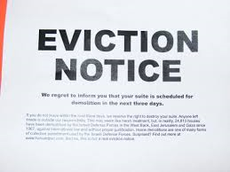
Starting the Eviction Process: Written Notice to Tenant
The eviction process should always begin with written notice to tenant—the type and length of notice may depend on why eviction and type of tenancy
Check the terms of lease first
Now three types: A Notice to Terminate Tenancy, a Notice of No Fault Eviction, or a Demand for Compliance.
Form notices available on courts website:
www.courts.state.co.us
Click on “Self Help/Forms”, then select Self-Help Category of “Housing Cases.”

Slide 19
Notice of No-Fault Eviction
If a landlord is not renewing a lease and the “for cause” protections apply, and the landlord does have a valid reason for not renewing the lease, then the landlord should give a Notice of No-Fault Eviction.
Must give Notice of No-Fault Eviction at least 90 days before proceeding with eviction.

Slide 20
Definitions
Employer-provided housing agreement
a residential tenancy agreement between an employee and an employer when the employer or an affiliate of the employer acts as a landlord.
Exempt residential agreement
residential agreement leasing a single family home by a landlord who owns five or fewer single family homes and who provides notice in the agreement that a ten-day notice period required pursuant to this section does not apply to the tenancy.

Slide 21
Notice to Terminate Tenancy
Used when landlord does not want to renew lease and “For Cause” policy does not apply.
Length of notice depends on term of tenancy—see C.R.S. §13-40-107
Notice period calculated from end of term (e.g. 21 days from end of month)
Term of Tenancy: | Length of Required notice:
1 year or more | 91 days
6 months or more, but less than 1 year | 28 days
1 month or more but less than 6 months | 21 days
1 week or more, but less than one month; tenancy at will | 3 days
Less than 1 week | 1 day

Slide 22
Notice to Terminate Tenancy
Repeat Minor Violation
Clearly indicate the provision/term of lease violated
Must have given previous notice for same violation
Tenant has 10 days to leave property (3 days for nonresident tenancy or an employer-provided housing tenancy, 5 days exempt residential agreement)
Does not give tenant the opportunity to cure by complying with term of lease
Substantial Violation
Tenant has 3 days to leave property
Does not give tenant opportunity to cure violation
Notice must indicate violation and must fall within statutory definition of “substantial violation”
There are some exceptions—e.g. for victims of Domestic Violence (can still evict offender)

Slide 23
“Substantial Violation”
Refers to an action by the tenant or a guest or invitee of the tenant that occurs on or near the property and:
Endangers the person or willfully and substantially endangers the property of landlord, co-tenant or person living on or near premises;
Is a violent or drug-related felony; or
Is declared a public nuisance and carries a potential sentence of 180 days or more.
See C.R.S. § 13-40-107.5

Slide 24
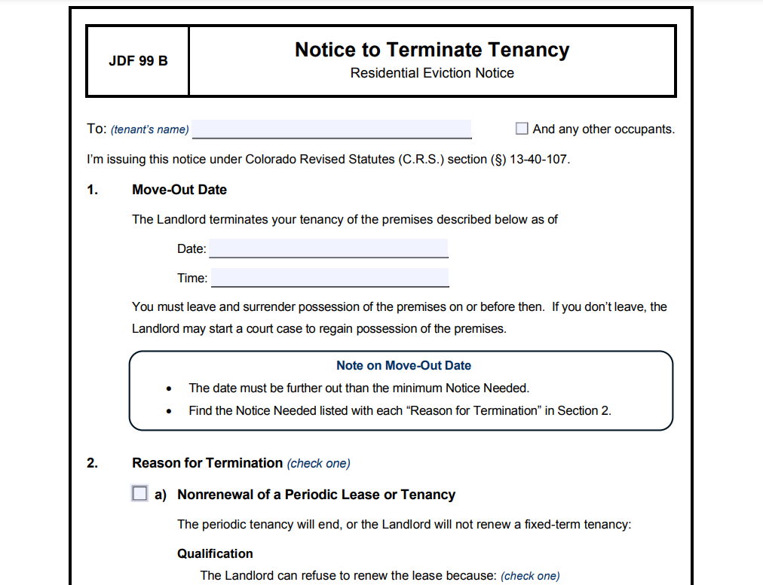
Notice to Terminate Tenancy

Slide 25
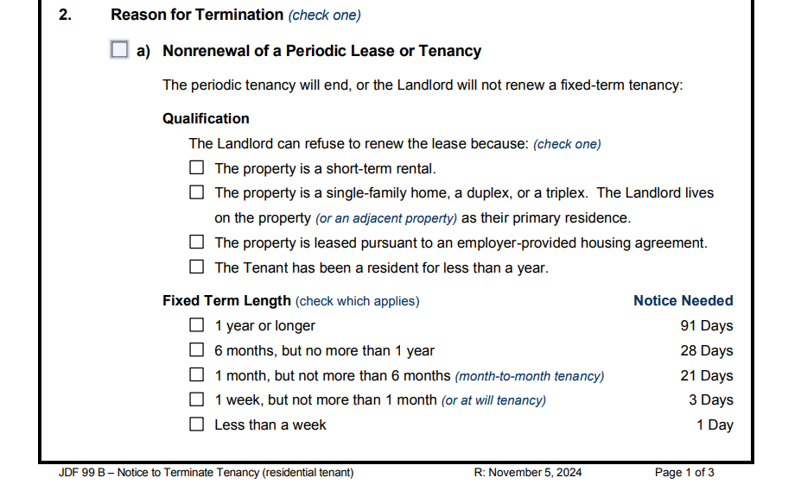
Notice to Terminate Tenancy

Slide 26
Steps in Giving Notice:
1) Service of Notice—Notice must be hand delivered to tenant or posted in conspicuous place on property after attempting personal service at least twice on two separate days.
2) Wait notice period—Starts on day after notice posted and cannot end on a Saturday, Sunday or holiday (will run to next business day).
3)a. Tenant gets out or complies—end of process.
OR
3)b. Tenant does not leave property—start an FED (eviction) case with the court.

Slide 27
Demand for Compliance or Right to Possession
Non-payment of Rent
Material violation of lease
Identify amount of rent owed and dates owed for
Gives tenant 10 days (3 days if nonresident agreement or an employer-provided housing agreement, 5 days if exempt residential agreement) to leave property OR comply by paying rent owed
Must specifically allege how tenant violated lease.
Gives tenant 10 days (3 days if nonresident agreement or an employer-provided housing agreement, 5 days if exempt residential agreement) to leave property OR comply by curing lease violation

Slide 28
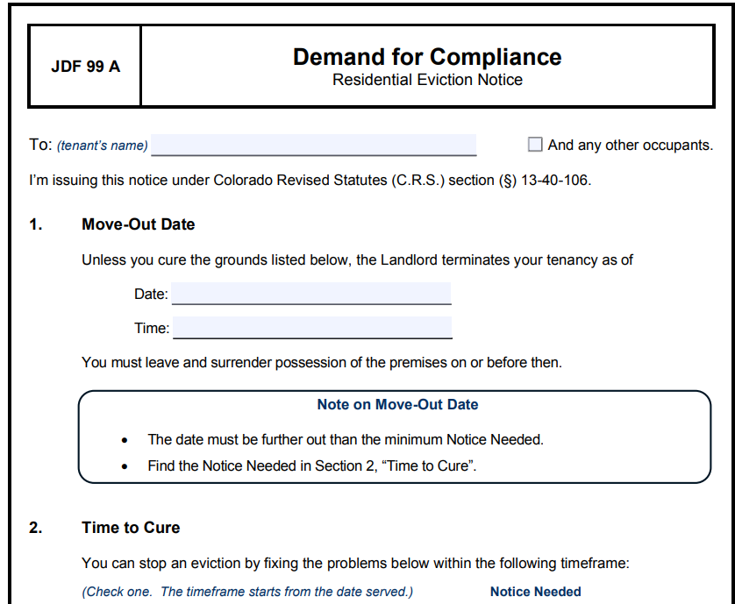
Demand for Compliance or Right to Possession

Slide 29
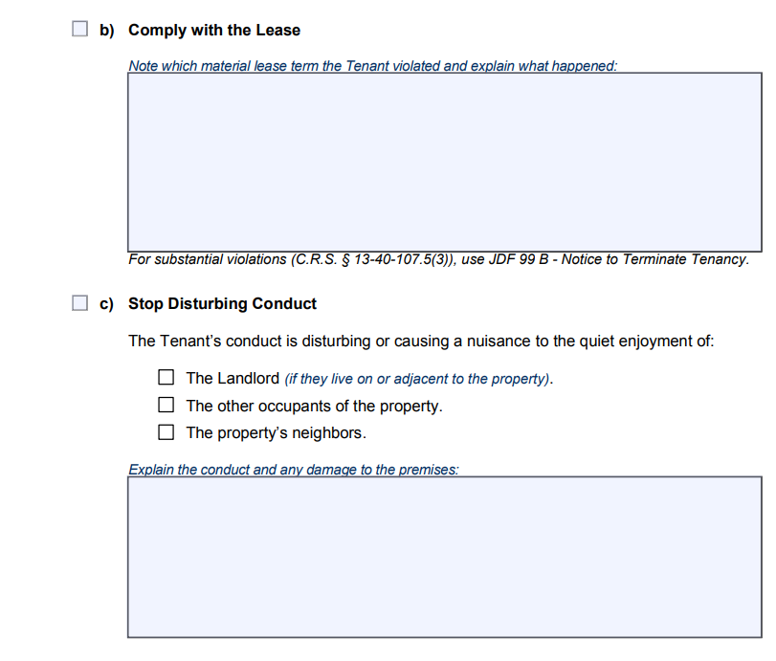
Demand for Compliance or Right to Possession

Slide 30
Steps in Giving Demand for Compliance:
1) Service of Demand for Compliance—Demand must be hand delivered to tenant or posted in conspicuous place on property after attempting personal service at least twice on two separate days.
2) Wait for required demand period—Starts on day after notice posted and cannot end on a Saturday, Sunday or holiday (will run to next business day).

Slide 31
Steps in Giving Demand for Compliance:
Continued…
3) During the demand period, mediation must be held if the tenant qualifies and the landlord is not exempt or if it is required by judge (next slide)
4)a. Tenant gets out or complies—end of process.
OR
4)b. Tenant does not comply or leave property—start an FED (eviction) case with the court.

Slide 32
Everything in tenant’s primary language
All demands and notices must be written in the tenant’s primary language.

Slide 33
Mediation through Office of Dispute Resolution
A tenant qualifies for mandatory mediation through ODR if they receive SSI, SSDI, or TANF.
Any demand issued must include a statement informing the tenant about mandatory mediation.
If a tenant qualifies, they should let the landlord know in writing immediately.
After landlord learns that tenant qualifies, landlord should schedule mediation with tenant and the Office of Dispute Resolution online or at 720-625-5940.
A landlord with five or fewer properties is exempt from having to do mandatory mediation with the tenant.

Slide 34
Starting a Court Case: WHO can bring the case?
The action must be filed by a “person in interest”, i.e. the property owner or other individual or entity identified as the landlord or lessor on the lease. If you are the property manager or the individual or entity acting as an agent for the owner(s), you may be required to show proof of your authority to the Court.
NOTE: The general rule is that corporations and other entities must be represented by an attorney in court cases—C.R.S. § 13-93-101
There is an exception for “closely-held entities” with no more than 3 owners—C.R.S. §13-1-127

Slide 35
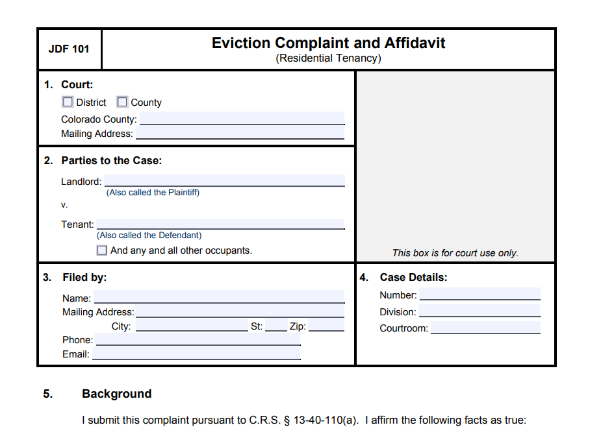
WHAT is needed to start a court case?
Complaint (Form JDF 101)
Attach copy of written lease, if any
Attach copy of Notice served on tenant
Summons (Form CRCCP 1A)
If you are not represented by an attorney, complete the top portion only and clerk will fill in the rest when you file. The Summons must include resource list (provided by and updated by the Department of Local Affairs).
The clerk will schedule a return date that should be between 7 and 14 days from the day you file
Answer (JDF 103), Request for Documents (Form 185 SC), Fee Waiver (JDFs 205 and 206) and Resource List (Form 186 SC).
Leave these blank and include with the documents served on the tenant.
Filing fee
County Court if Less than $1,000 Filing Fee $85
County Court if $1,000 up to $15,000 Filing Fee $105
County Court if $15,000 up to $25,000 Filing Fee $135
District Court is anything above $25,000 Filing Fee $235

Slide 36
Service of Summons and Complaint
The tenant must be served with the Summons and Complaint by someone who is over 18 and not related to your case (e.g. a process server or law enforcement)
Whoever serves the tenant should complete an affidavit of service (form JDF 98)
The tenant must be served no later than 7 days before the return date.
Service should be accomplished by handing the papers directly to the tenant or a member of his family over 18, if possible. If not possible, service can be accomplished by posting the papers in a conspicuous location on the property and mailing a copy to the tenant
Note: If service is accomplished by posting and mailing, rather than personal service, the court can enter an order regarding possession of the property, but will not be able to enter a money judgment for back rent, damages, etc.

Slide 37
Tenant may file an Answer to the Complaint on or before the court date
Possible defenses may include:
Did not receive/inadequate notice or improper service of notice*
Improper service of Summons and Complaint*
Tenant paid rent or cured violation within the Notice period
Tenant tried to pay rent within the notice period, but landlord refused payment
Landlord agreed to accept late rent payment or accept work in trade for rent
DO NOT IGNORE A TENANT’S ANSWER
Answer may contain defense to your Complaint you will need to address in court
Answer may contain a counterclaim against landlord
Along with Answer, Tenant may demand a jury trial on factual issues in FED-possession cases.
*defense must be raised in answer, cannot be raised for 1st time at trial

Slide 38
Possible Defenses: Continued
Landlord accepted rent after lease violation occurred and/or notice given
No lease violation or failure to pay rent occurred
Eviction for substantial violation—actions do not meet requirements of “substantial violation”
Eviction for substantial violation—victim of domestic violence
Tenant able to pay the landlord rent owed before the judge orders possession for the landlord.
Tenant used rent money to repair premises and deducted cost from rent after giving notice to landlord of repairs needed and landlord fails to make repairs
Landlord failed to offer mandatory mediation.
Landlord evicting tenant in retaliation for tenant making report to government about landlord or property
Eviction due to unlawful discrimination

Slide 39
Warranty of Habitability Law -Before SB24-094
Every residence must be habitable.
List of conditions in the statute (38-12-505)
Lack of functional appliances;
Lack of weather protection;
Lack of functional plumbing or gas facilities;
Lack of running water and reasonable amounts of hot water;
Appropriate extermination of pests;
Non-functioning locks;
Compliance with building codes;
Reasonably clean and safe common areas.
Beyond that, must be in a condition that does not “materially interferes with the tenant’s life, health, or safety.”

Slide 40
Whose Responsibility to Fix?
Generally always the landlord’s obligation to fix conditions mentioned above.
Exception for single family homes in certain circumstances where there is a:
Separate written agreement that tenant will fix, and
Tenant has adequate skills to fix the condition, and
The tenant will not have to do anything that would endanger their health or safety

Slide 41
What should a tenant do?
Provide notice to your landlord
Always should be in writing using whatever method your landlord normally communicates with you.
Describe the condition and use pictures if helpful.
Give the landlord permission to enter the property.
Tell the landlord what steps you will take if the landlord does not take action.
Do NOT try and fix the condition yourself (unless there is a written agreement with the landlord to do so)

Slide 42
What should a landlord do?
Respond to tenant’s notice within 24 hours to tell them what steps you will take to fix.
Begin to take action to fix the conditions as soon as possible.
If the condition is threatening the health of the tenant, within 24 hours. If it is a condition listed above, within 72 hours.
If the tenant’s health is threatened, provide another place for the tenant to stay.

Slide 43
Tenant’s Remedies
End the lease agreement and move out.
Must give your landlord at least 5 business days to begin fixing after you gave notice.
Get a court order requiring your landlord to fix the condition and/or compensate the tenant.
Deduct the cost of fixing the condition from the monthly rent.
All of these steps require that the tenant to follow specific procedures, and failure to do so can result in the tenant owing more money to their landlord.
It is highly recommended that the tenant contact an attorney before moving forward with these steps.

Slide 44
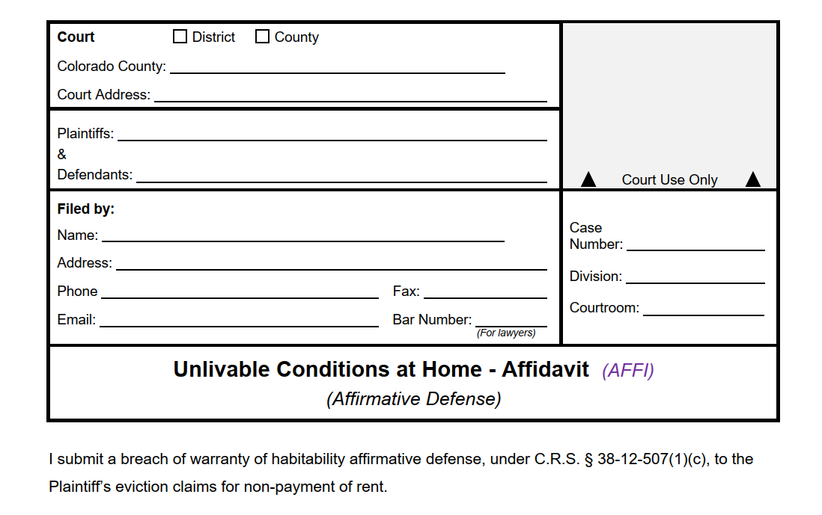
Tenant’s Remedies Continued…
The tenant can bring these conditions up as an “affirmative defense” if they are being evicted.
Use JDF 104
The tenant may be required to deposit the amount of rent due to the landlord, depending on their income.

Slide 45
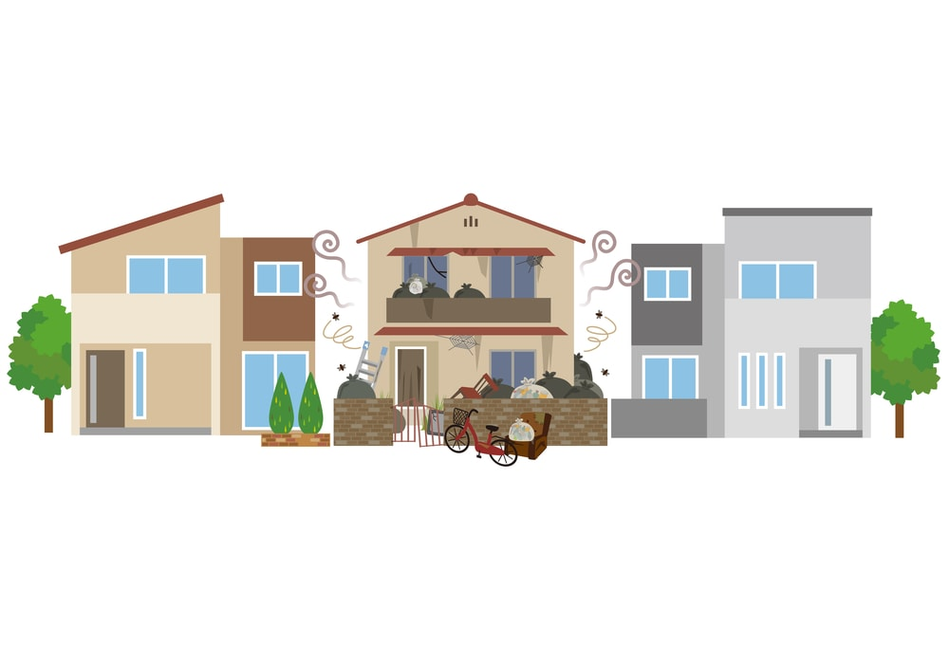
Landlord’s Defenses
The tenant’s misconduct has caused the condition.
The tenant’s actions or inactions have prevented you from fixing the condition.
The condition was caused by a third party not under your control and you have done what you can to fix the condition.

Slide 46
Warranty of Habitability Law
Lots of Changes as of May 3, 2024
SB24-094 Safe Housing for Residential Tenants
https://leg.colorado.gov/sites/default/files/2024a_094_signed.pdf
In a nutshell:
SB24-094 expands grounds for WoH claims and the available relief if claims are successful. It expands on various definitions (e.g., “appliance” includes “air conditioner unit”). The Act also clarifies procedures for LL and T when a claim is alleged and creates specific discovery procedures.

Slide 47
Other Changes Implemented by SB24-094 include:
Requires rental agreements entered into after 1/1/25 to contain a statement in bold font in English and Spanish regarding where a T can report or deliver written notice of an unsafe or uninhabitable condition;
Creates a rebuttable presumption that a LL has failed the LL’s duties to remedy or repair a condition if the condition continues to exist either 7 or 14 days after the LL has notice of the condition, depending on the condition at issue;
Requires a LL to maintain all records relevant to a T's claim and any remedial actions taken by the LL;
Establishes procedures for when a LL may enter the dwelling unit of a T to address an uninhabitable condition and identifies circumstances in which a T may deny a LL entry to the dwelling unit;
Requires a LL to provide a T with a comparable dwelling unit or hotel room for up to 60 days while the LL addresses any uninhabitable conditions that materially interfere with the T's life, health, or safety;

Slide 48
SB24-094 Cont’d:
Allows Ts to obtain an ex parte TRO if the condition materially affects life, health, or safety, LL had notice, and LL failed to repair
Clarifies certain conditions or characteristics of residential premises that are considered uninhabitable;
Creates a rebuttable presumption that certain conditions and characteristics of a residential premises materially interfere with a T's life, health, or safety;
Modifies a T's option for remedies when bringing a claim against a LL;
Prohibits retaliation and specifies what actions constitute retaliation by the LL; and
Provides guidance to courts in calculation of actual and punitive damages for breach of WoH.

Slide 49
BEFORE the court date
*Note: The court date on the summons is a deadline for the tenant to file an Answer. If the tenant files an Answer, a trial date will be set between 7 and 10 days later (C.R.S. 13-40-113(4)(a))
You may be required to participate in mediation prior to your court date
If you and the tenant come to an agreement, you can file a Stipulation (written agreement signed by both of you) with the court and ask to vacate the hearing.
Prepare for your court appearance.
On October 21, 2024, the Colorado Supreme Court held parties may demand a jury trial on factual disputes in FED-possession cases – (more on this in next slide).
You are responsible for getting any evidence you want to present to the court—this means arranging for any witnesses to be available to testify and having 3 copies of any documents, pictures, or other evidence with you when you come to court

Slide 50
Jury Trials in FED-Possession Cases
In re Mercy Housing Management Group Inc. v. Bermudez, 2024 CO 68 (announced 10/21/24)
Issue Court Considered and its Conclusion:
“The question for us is whether [the tenant] is entitled to a jury trial on the factual disputes underlying this FED-possession action.” Id. at 2.
“[W]e hold that there is a right to a jury trial on any factual disputes in FED-possession actions.” Id. at 3.
Additional Points:
“[S]o long as landlords or tenants timely demand a jury trial and pay the requisite jury fee in an action for the recovery of real property, they are entitled to a jury trial on all issues of fact, regardless of whether the plaintiff seeks money damages.”
“[I]n order to receive a jury trial, a party must timely request a jury and pay the jury fee.”
“[T]he parties may waive a trial by jury.”

Slide 51
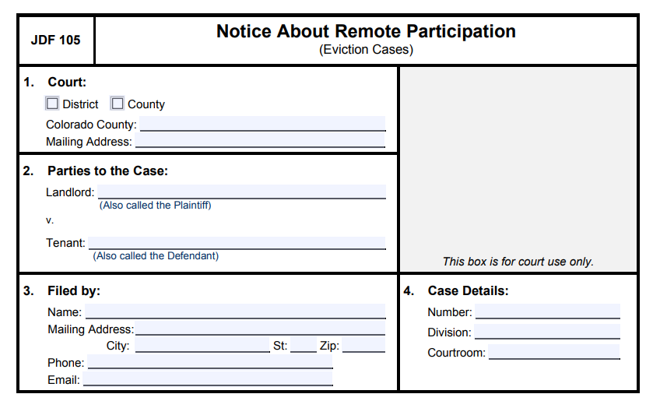
Remote Participation
Any party or witness can choose to participate in eviction proceedings remotely.
If you use the JDF Complaint or Answer, you will be able to choose on that form.
If you change your mind at least 48 hours before the court date, use JDF 105.

Slide 52
The Trial
As the Plaintiff, you will have the burden of proof, so it will be your job to prove what you are claiming
Includes proving damages—do you have before and after pictures? Checklists?
Both sides will have the opportunity to give testimony, have witnesses testify, and present evidence to the court
The judge and the other party will be able to ask you (if you testify) and any of your witnesses questions
You will be able to ask questions of the tenant (if he/she testifies) and any of the tenant’s witnesses
Make sure to actually ask questions, and not argue or talk over the witness
Remember to be organized, prepared, and respectful at all times

Slide 53
The Trial Cont’d
Jury Trials
Either party can demand one, but the fee must be paid at the time of the demand.
Jury trials will be more involved than court trials:
You’ll need to prepare for jury selection
Depending on the judge’s preferences, you may have to create juror notebooks
You’ll have to consider jury instructions

Slide 54
After trial → if you win
Order for Possession
Money Judgment
Judge orders possession of the property returned to you.
After 48 hours, you can ask the court to issue a Writ of Restitution (form JDF 103)
The Writ of Restitution directs the Sheriff to assist you in forcibly removing the tenant from the property. The Sheriff cannot “execute the writ” (remove the tenant) until at least 10 days have passed since judgment was entered, or 30 days if the tenant receives SSI, SSDI, or TANF.
Judge enters a judgment in your favor for back rent, damages, etc.
May be an additional hearing on damages after possession returned to landlord
Court costs usually awarded to prevailing party—whether attorney fees awarded depends on terms of your lease agreement
Can collect like any other money judgment, but it is your responsibility—the court does not do this for you
For more information see Form JDF 82 on the Courts website

Slide 55
Removing the tenant and belongings from property
If the court issues a Writ of Restitution, it will be your responsibility to make arrangements with the Sheriff’s office to go execute the Writ
The Sheriff’s office will supervise, but likely will not participate in physically removing any of tenant’s belongings from property—it will be your responsibility to make arrangements to have someone physically move the belongings
If you (or someone under your direction) are physically moving the belongings, you can legally move them as far as the street and you have no further obligation—if you undertake to store the possessions, you may be taking on additional obligations/liabilities
Abandoned property—See C.R.S. § 38-20-116 or consult an attorney

Slide 56
Special Thanks!
THANK YOU FOR COMING!!!
- 12th Judicial District Access to Justice Committee
- Center for Restorative Programs
La Puente
Century Property Management and Sales, LLC

