Slide 1
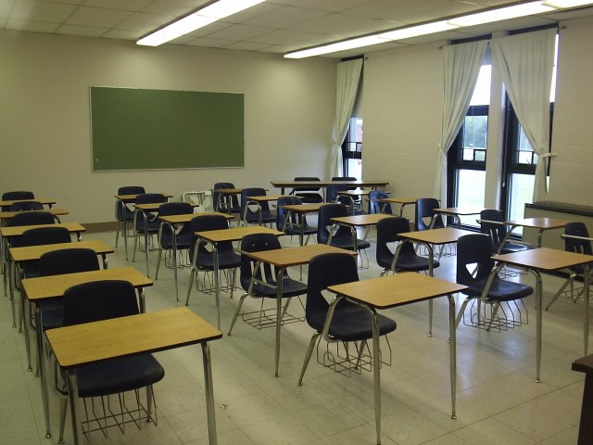
12th Judicial District Truancy Protocol

Slide 2
Resources (all available on court’s website – URL on last slide)
12th Judicial District Truancy Protocol
This provides a broad overview of the process of a truancy matter
12th Judicial District Truancy Checklist
This is intended to assist school districts in preparing for and litigating a truancy petition
Attachments to Truancy Protocol
These attachments are forms that should be used for purposes of truancy matter (e.g., Petition to Compel Attendance and corresponding proposed order)
*Recommendation: Review the protocol first and then use the checklist to ensure all the statutory requirements are satisfied.

Slide 3
The Steps of a truancy case
There are four phases in a truancy case:
*Before filing with the court
Filing with the court
Appearing in court
Enforcing the court’s order
* The focus of this presentation is
on the preliminary requirements
school districts must satisfy during
phase one.

Slide 4
Phase 1. Before filing with the court
Phase 1 is important because a school district will not be able to successfully file a petition with the court unless the statutory prerequisites are satisfied.
The statutory prerequisites are outlined in C.R.S. § 22-33-101 et seq. — i.e., the School Attendance Law of 1963 (aka the “School Attendance Law”).

Slide 5
Phase 1. Before filing with the court
Each school district shall designate one or more employees to act as attendance officer(s).
“It is the attendance officer’s duty in appropriate cases to counsel with students and parents and investigate the causes of nonattendance and report to the local board of education so as to enforce the provisions [of the School attendance Law].” C.R.S. § 22-33-107(1).
Judicial proceedings can be initiated by the school district’s attorney, the local board of education, or the school district’s attendance officer.
The school district must determine that the student is a “habitual truant” according to its policies and Colorado’s School Attendance Law.
The school district must develop a treatment or intervention plan to assist the student to remain in school.
Despite the treatment plan, the student must continue to be a habitual truant.

Slide 6
Phase 1. Before filing with the court
“Child who is habitually truant” means a child:
between the ages of 6 and 17,
who has 4 unexcused absences in any one month or 10 unexcused absences during any school year.
C.R.S. § 22-33-102(3.5).
Regarding excused absences:
Each school district “is encouraged to establish attendance procedures for identifying students who are chronically absent and to implement best practices and research-based strategies to improve the attendance of students who are chronically absent.”
C.R.S. § 22-33-104(4)(b.5).

Slide 7
Phase 1. Before filing with the court
Written Attendance Policy
Each board of education must adopt a written attendance policy setting forth the school district’s attendance requirements, and this attendance policy must explain what the school district classifies as an excused absence.
Statutory provision:
“The board of education shall adopt a written policy setting forth the district’s attendance requirements. The policy must provide for excused absences, including those listed as exclusions from compulsory school attendance . . . as well as temporary absences due to behavioral health concerns.”
C.R.S. § 22-33-104(4)(a).

Slide 8
Phase 1. Before filing with the court
Written Attendance Policy
The attendance policy must determine the maximum number of unexcused absences a student may incur before the attorney for the school district, the attendance officer, or the local board of education may initiate judicial proceedings.
Statutory provision:
“The attendance policy . . . shall specify the maximum number of unexcused absences a child may incur before the attorney for the school district, the attendance officer, or the local board of education may initiate judicial proceedings . . .”
C.R.S. § 22-33-104(4)(b).

Slide 9
Phase 1. Before filing with the court
Develop a Plan to Assist the Student to Remain in School
Once a school district identifies the child as “habitually truant,” it is required to develop a treatment or intervention plan.
The plan will help the child to remain in school, with the full participation of the child's parent, guardian, or legal custodian when practicable.
School personnel must make all reasonable efforts to meet with the parent, guardian, or legal custodian of the child to review and evaluate the reasons for the child’s truancy.
School personnel are encouraged to work with local community services to develop the plan and the plan must include appropriate sanctions other than placement in a juvenile detention facility for a child who is habitually truant and who has refused to comply with the plan.
The “local community services group” = Center for Restorative Programs
CRP Info — (719) 589-5255 | https://restorativeprograms.org

Slide 10
Phase 1. Before filing with the court
Develop a Plan to Assist the Student to Remain in School
Statutory provision:
“The board of education of each school district shall adopt and implement policies and procedures concerning elementary and secondary school attendance, including but not limited to policies and procedures to work with children who ae habitually truant. The policies and procedures must include provisions for the development of a plan. The plan must be developed with the goal of assisting the child to remain in school and, when practicable, with the full participation of the child’s parent, guardian, or legal custodian. . .”
C.R.S. § 22-33-107(3)(b).

Slide 11
Phase 1. Before filing with the court
Develop a Plan to Assist the Student to Remain in School
Statutory provision cont’d:
“. . . Appropriate school personnel shall make all reasonable efforts to meet with the parent, guardian, or legal custodian of the child to review and evaluate the reasons for the child’s truancy. The appropriate school personnel are encouraged to work with the local community services group to develop the plan. The plan must . . . include appropriate sanctions other than placement in a juvenile detention facility for a child who is habitually truant and who has refused to comply with the plan.”
C.R.S. § 22-33-107(3)(b).

Slide 12
Phase 1. Before filing with the court
If the plan isn’t successful, the school district may file a petition with the court.
However, a school district “shall employ best practices and research-based strategies to minimize the need for court action . . .” Court proceedings are a “last-resort approach” and, as such, can only be initiated after the school district has created and implemented a treatment or intervention plan and the student continues to be habitually truant.
C.R.S. § 22-33-108(5)(a),(b).

Slide 13
Phase 1. Before filing with the court
Provide Written Notice
Once a school district decides to file a petition with the court, it must provide written notice to the student’s parent, legal guardian, or legal custodian in two ways:
Send a letter (Attachment 1 - Sample Letter); or
Combine the written notice with the summons and the petition (Attachment 2 - Petition to Compel Attendance and Attachment 3 – Summons to Appear)
The school district must send the written notice 5 days before filing with the court.

Slide 14
Phase 1. Before filing with the court
Provide Written Notice
Statutory provision:
“Before initiating court proceedings to compel compliance with [the School Attendance Law], the school district shall give the child and the child’s parent written notice that the school district will initiate proceedings if the child does not comply with the attendance requirements of this article. The school district may combine the notice and summons. If combined, the petition must state the date on which the school district will initiate proceedings, which date must not be less than five days after the date of the notice and summons. The notice must state the provisions of [the School Attendance Law] with which compliance is required and must state that the school district will not initiate proceedings if the child complies with the identified provisions before the proceedings are filed.”
C.R.S. § 22-33-108(5)(c).

Slide 15
The Phases of a truancy case
There are four phases in a truancy case:
Before filing with the court
Filing with the court
Appearing in court
Enforcing the court’s order

Slide 16
Phase 2. Filing with the court
When the school district files a petition with the court, it must also file a Summons to Appear and Notice (Attachment 2);
Note: The school district must serve the petition and the summons on the parents of the truant student at least 5 days before the court date.

Slide 17
phase 2. Filing with the Court
The Petition (Attachment 2) must also include:
A copy of the written notice (either the letter or the combined forms);
The student’s attendance record (before and after the student was identified as habitually truant);
Information about the treatment plan (described above) and its successes and failures.

Slide 18
phase 2. Filing with the court
Once the school district satisfies these requirements, a court date will be set.

Slide 19
The phases of a truancy case
There are four phases in a truancy case:
Before filing with the court
Filing with the court
Appearing in court
Enforcing the court’s order

Slide 20
phase 3. The truancy hearing
The purpose of the truancy hearing is to determine whether the court should order the student to attend school, order the parents to assist the student, and order other plans designed to ensure attendance.

Slide 21
phase 3. The truancy hearing
The school district should bring these documents to the hearing:
An up-to-date report on the student’s attendance and efforts to secure his/her attendance. (Attachment 6 - “Valid Court Order Written Report”)
An advisement of rights (Attachment 7) for the student and parents to fill out.
A return of service (Attachment 4), showing that the respondents were served.
These documents will avoid unnecessary delay by ensuring everyone is ready to proceed.

Slide 22
phase 3. The truancy hearing
In addition to these documents, the school district will have to prepare other forms, but these will depend on whether the school district, the student, and the parents reach a stipulation.

Slide 23
Phase 3. The truancy hearing
If the parties reach a stipulation (an agreed-upon resolution) before the hearing, the school district must prepare the following documents:
A Stipulation (Attachment 8).
A proposed Valid Court Order for Status Offenders (Attachment 9).

Slide 24
phase 3. The truancy hearing
The Stipulation (Attachment 8) must be signed by all parties before the hearing.
The Stipulation must be served on all parties after the judge signs it.

Slide 25
phase 3. The truancy hearing
If the parties do not reach a stipulation, the school district only needs to prepare the Valid Court Order Compelling Attendance (Attachment 9).

Slide 26
phase 3. The truancy hearing
Review of Required Documents
Stipulation | No Stipulation
Report (Attachment 6) | Report (Attachment 6)
Advisement of Rights (Attachment 7) | Advisement of Rights (Attachment 7)
Return of Service (Attachment 4) | Return of Service (Attachment 4)
Stipulation (Attachment 8) | Valid Court Order (Attachment 9)
Valid Court Order (Attachment 9)
Notes:
Summary of forms needed for the hearing.

Slide 27
phase 3. The truancy hearing
A Note on Preparing for the Hearing
In preparing for the hearing, bear in mind that the school district will need to prove the facts claimed in the Valid Court Order Compelling Attendance (Attachment 9).

Slide 28
phase 3. The truancy hearing
For example, the school district will need to prove that the student has four unexcused absences in one month and/or the student has ten unexcused absences during any school year.
Even if the school district does not have an attorney, it will still have to comply with the Colorado Rules of Evidence in making its case.

Slide 29
phase 3. The truancy hearing
Preparation is key:
A truancy case will involve more than just preparing the forms and the court cannot help school districts prove their cases.
The court must remain neutral. As such, unless all of the statutory requirements are satisfied, the court cannot enter an order compelling attendance.

Slide 30
phase 3. The truancy hearing
For most cases, the order compelling attendance will be the end of the court proceedings.
However, if the school district finds that the student and/or the parent(s) are not following the court’s order, the school district can begin proceedings to enforce the order (i.e., contempt proceedings).

Slide 31
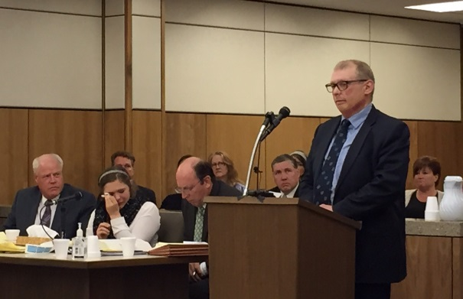
The phases of a truancy case
There are four phases in a truancy case:
Before filing with the court
Filing with the court
Appearing in court
Enforcing the court’s order

Slide 32
phase 4. Enforcing the court’s order
The school district must initiate enforcement proceedings by filing:
A Verified Motion for Contempt Citation(Attachment 10); and
The corresponding proposed order to issue a contempt citation (Attachment 11).

Slide 33
phase 4. Enforcing the court’s order
When filing a Verified Motion for Contempt Citation, the school district must:
Provide the correct title of the court order;
Provide the date of the court order; and
Specify how the student or the parents or both violated the court order.

Slide 34
phase 4. Enforcing the court’s order
If the court grants the school district’s motion and issues the contempt citation, a hearing will be set on the contempt citation.

Slide 35
phase 4. Enforcing the court’s order
Before the hearing, the school district must determine whether it is seeking detention or some other consequence for violating the court order and bring the appropriate proposed order:
If the school district is seeking detention, it must prepare a proposed order imposing it (Attachment 13).
Otherwise, the school district must prepare proposed order imposing other sanctions (Attachment 12).

Slide 36
phase 4. Enforcing the court’s order
If, after a contempt hearing is scheduled, the school district decides it is inappropriate or unnecessary to go through with the hearing, the district must file the following:
A Motion to Dismiss (Attachment 15), and
The corresponding proposed order granting dismissal (Attachment 16).

Slide 37
phase 4. Enforcing the court’s order
If the school district goes forward with the hearing, the district will have to consider how to present its case.
If the court finds that the respondents failed to comply with the order compelling attendance, the court will impose a sentence. The school district and respondents will have an opportunity to recommend an appropriate sentence.
As discussed in the truancy protocol and 12JD CJAO 16-04, it is the policy of the 12JD that alternatives to detention be used as sanctions whenever possible.

Slide 38
THANKS FOR ATTENDING
To download the Protocol, Checklist, Attachments, and this Powerpoint, visit the 12JD Court Business Resources Website:
https://www.coloradojudicial.gov/courts/trial-courts/alamosa-county/court-business-resources?topic=10&wrapped=true

