Slide 1
Understanding the Eviction Process
Presented by the12th Judicial District Access to Justice Committee

Slide 2
Panel Discussion
Panel members:
Judge Craig Schuenemann, Saguache County Judge
John Montgomery, private attorney;
Chad Keizer, Staff Attorney, Colorado Legal Services
Roxy Gehring, Center for Restorative Programs
Moderated by Judge Kimberly Cortez, District Court Judge for 12th Judicial District.

Slide 3
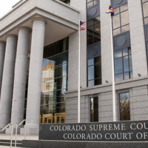
Why are we here?
Access to Justice Committee
  Educate community members about court processes and provide resources for better access to the courts
Important for tenant, landlord, and court that landlords understand how to proceed with an eviction correctly and understand and respect tenants’ rights in the process
  Less confusion = less conflict

Slide 4
What to expect from this presentation:
General overview of how the eviction process works: what to do and what not to do
Conditions residences must be kept in
Local resources/mediation program
Return of Security deposits
Panel discussion
NOT COVERED: Special rules for evictions in a mobile home park; foreclosure evictions; collection of a money judgment; appeals

Slide 5
Resources for Eviction and Foreclosure Prevention
DOLA
https//cdola.Colorado.gov/office-of-homeless-initiatives
Rental Assistance for Property Owners (POP)
MODEL repayment agreements for tenants and landlords
MODEL notification of tenant protections
2-1-1
https://search.211colorado.org
Assistance Finding Food
Paying House Bills
Accessing Free Childcare
Other Essential Services
La Puente Home, Inc.
www.lapuentehome.org
(719)589-5909
Assistance with Food
Veterans Assistance
Rental Assistance
Utility Assistance
Medical Assistance

Slide 6
Resources for Eviction and Foreclosure Prevention Continued
SLV Pro Bono
Free Consultation
Colorado Legal Services
Provides Legal Assistance to Low-Income Individuals
Legal Help with Eviction
slvprobono1@hotmail.com
(719)589-6534
https://www.coloradolegalservices.org/
Holds Free Monthly Clinics (844)404-7400
(719)589-4993
3rd Wednesday of the Month
Community Economic Defense Project
Fighting Evictions and Homelessness in Colorado
Legal Help for evictions
https://cedproject.org
Colorado Poverty Law Project
Matching Low-Income Coloradans with Volunteer Attorneys
https://www.copvertylawproject.org
Holds Monthly Clinics Regarding Eviction and Housing Concerns

Slide 7
Center for Self-Reliance
Assists Elderly, and Disabled
Brothers Redevelopment
Elderly, Low-Income, and Disabled Housing Solutions
SLV@ILCPUEBLO.ORG
(719)289-0789
ehap@brothersredevelopment.org
(844)926-6632
The Salvation Army
Food Assistance, Utility Assistance, Connection Center
https://westernusa.salvationarmy.org/intermountain_us_west/covid-19-get-help/
(855)768-7977
Colorado Resource Network
Connecting Community and Legal Resources
www.coloradoresourcenetwork.com
Renters Avenue
https://www.rentersavenue.com/
Self-Help Assistance
Lisa Mizell
(719)589-7621
12selfhelp@judicial.state.so.us
If you don’t know where to start, you can always call the Eviction Hotline at (719) 301-5466
Free Mediation services are available, and in some counties are court ordered. You can set up mediation at any time during the process by calling (719)480-8728

Slide 8
Free Mediation Services
Center for Restorative Programs
Referrals:
  Call CRP Directly
  From the Court
  From La Puente
    Those in needs of assistance are assigned a caseworker to help with rental assistance and other resources.
Process:
  Both Landlord and Tenant to contact CRP
  CRP will hear from each side individually
  CRP schedule a time to meet for mediation
Outcomes:
  Successful mediation: we send the agreement to court
  Agreement not reached: we let the court know the parties attempted mediation and opted to go through court instead
  Mediation not reached: if one party can’t be contacted, mediation not possible.

Slide 9

Warranty of Habitability Law
Every residence must be habitable.
  List of conditions in the statute (38-12-505)
    Lack of functional appliances;
    Lack of weather protection;
    Lack of functional plumbing or gas
    facilities;
    Lack of running water and reasonable
    amounts of hot water;
    Appropriate extermination of pests;
    Non-functioning locks;
    Compliance with building codes;
    Reasonably clean and safe common areas.
  Beyond that, must be in a condition that does not “materially interferes with the tenant’s life, health, or safety.”

Slide 10
Whose Responsibility to Fix?
Generally always the landlord’s obligation to fix conditions mentioned above.
  Exception for single family homes in certain circumstances where there is a:
    Separate written agreement that tenant will fix, and
    Tenant has adequate skills to fix the condition.

Slide 11
What should a tenant do?
Provide notice to your landlord
  Always should be in writing, and preferably should be using the method specified in the lease.
  Describe the condition and use pictures if helpful.
  Give the landlord permission to enter the property.
  Tell the landlord what steps you will take if the landlord does not take action.
  Do NOT try and fix the condition yourself (unless there is a written agreement with the landlord to do so)

Slide 12
What should a landlord do?
Respond to tenant’s notice within 24 hours to tell them what steps you will take to fix.
Begin to take action to fix the conditions as soon as possible.
    If the condition is threatening the health of the tenant, within 24 hours. If it is a condition listed above, within 96 hours.
    If the tenant’s health is threatened, provide another place for the tenant to stay.

Slide 13
Tenant’s Remedies
End the lease agreement and move out.
    Must give your landlord at least 5 business days to begin fixing after you gave notice.
Get a court order requiring your landlord to fix the condition and/or compensate the tenant.
Deduct the cost of fixing the condition from the monthly rent.
All of these steps require that the tenant to follow specific procedures, and failure to do so can result in the tenant owing more money to their landlord. It is highly recommended that the tenant contact an attorney before moving forward with these steps.

Slide 14
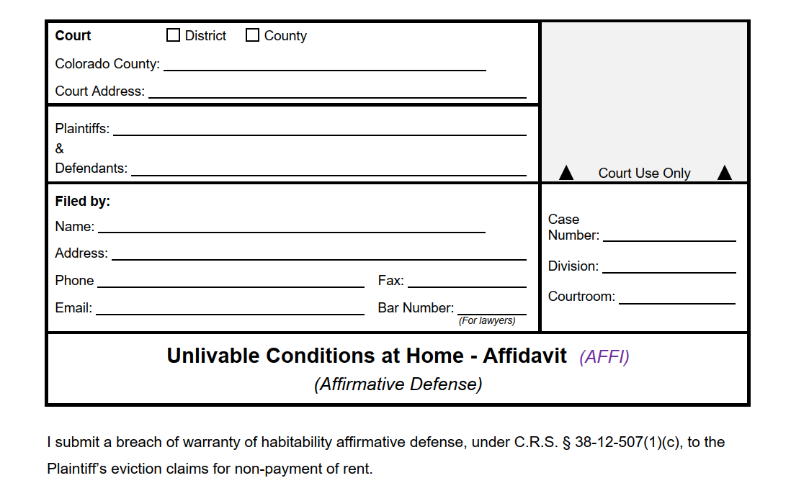
Tenant’s Remedies Cont.
The tenant can bring these conditions up as an “affirmative defense” if they are being evicted for failing to pay their rent.
Use JDF 109
The tenant may be required to deposit the amount of rent due to the landlord, depending on their income.

Slide 15
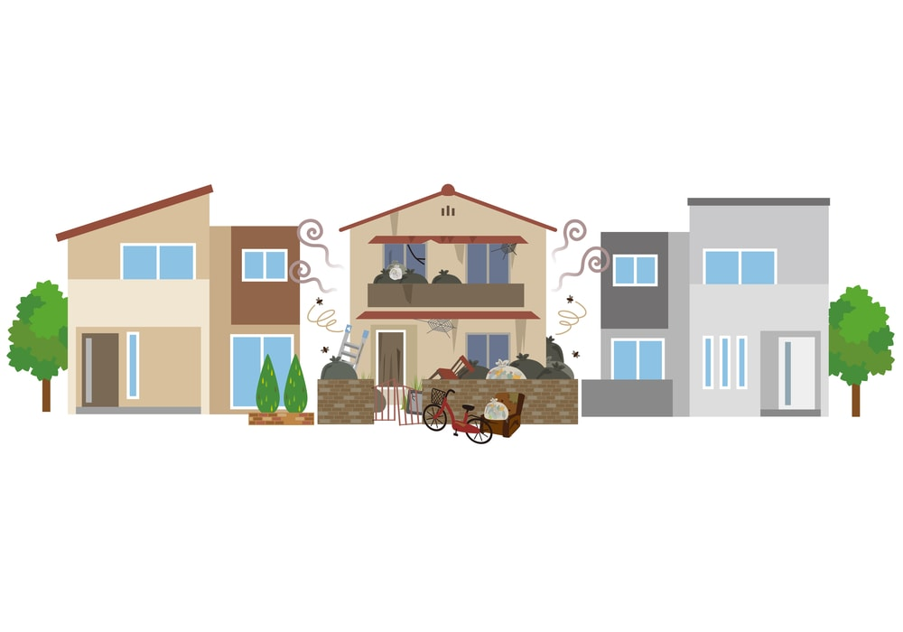
Landlord’s Defenses
The tenant’s misconduct has caused the condition.
The tenant’s actions or inactions have prevented you from fixing the condition.
The condition was caused by a third party not under your control and you have done what you can to fix the condition.

Slide 16

Before you begin… know your lease agreement!
Lease agreement does not necessarily have to be written to be enforceable, but it is preferable because it will make the terms clear
for the landlord, tenant, and court, if
necessary
Lease agreement should contain information/terms including:
  Term/duration of lease
  Type and length of notice required to terminate the tenancy
  What actions will constitute a violation of the lease and what happens when such a violation occurs

Slide 17

Terminating a Tenancy
No eviction required
  Tenant and landlord agree to a move-out date voluntarily
  End of term—lease period ends on definite date, depending on terms of lease, no notice required
  NOTE: if you accept rent after the date the lease was set to terminate, you may have extended the tenancy for another term
Eviction required
  Ending a tenancy with no definite end date
  Termination due to violation of terms of lease agreement
  Forcible Entry and Detainer—see C.R.S. § 13-40-101
  Unlawful Detention—see C.R.S. §13-40-103

Slide 18

Starting the Eviction process:
Landlord CANNOT simply lockout a tenant or turn off heat, electricity, water or other utilities
  Called a constructive eviction and it is a violation of the tenant’s rights and may result in liability on the part of the landlord for tenant’s damages
Landlord CANNOT simply call the Sheriff to come and remove a tenant—Sheriff’s office will not assist in removing a tenant without a court order directing them to do so
What NOT to do

Slide 19
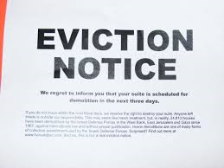
Starting the Eviction Process:
Written Notice to Tenant
The eviction process always begins with written notice to tenant—the type and length of notice may depend on why eviction and type of tenancy
Check the terms of lease first
Form notices available on courts website:
  www.courts.state.co.us
    Click on “Self Help/Forms”, then “All Court Forms & Instructions” then “Housing (Evictions, Foreclosures, and Unauthorized Persons Removal)”

Slide 20
Definitions
Employer-provided housing agreement – a residential tenancy agreement between an employee and an employer when the employer or an affiliate of the employer acts as a landlord.
Exempt residential agreement – residential agreement leasing a single family home by a landlord who owns five or fewer single family homes and who provides notice in the agreement that a ten-day notice period required pursuant to this section does not apply to the tenancy entered into pursuant to the agreement.

Slide 21
Demand for Compliance or Right to Possession
Non-payment of Rent
Minor violation of lease
Identify amount of rent owed and dates owed for
Gives tenant 10 days (3 days if nonresident agreement or an employer-provided housing agreement, 5 days if exempt residential agreement) to leave property OR comply by paying rent owed
Clearly identify the provision/term of lease that was violated
Gives tenant 10 days (3 days if nonresident agreement or an employer-provided housing agreement, 5 days if exempt residential agreement) to leave property OR comply by curing lease violation

Slide 22
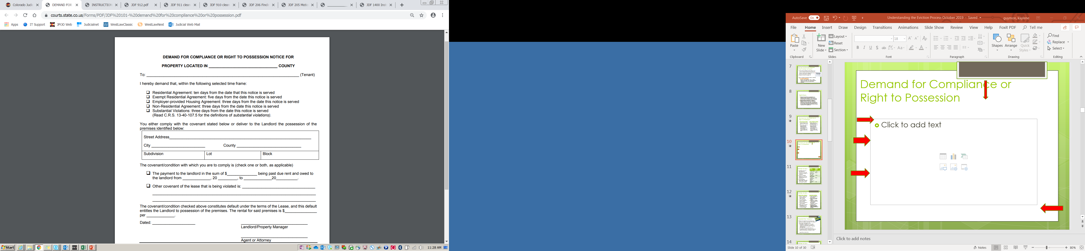
Demand for Compliance or Right to Possession

Slide 23
Notice to Quit
Term of Tenancy: | Length of Required notice:
1 year or more | 91 days
6 months or more, but less than 1 year | 28 days
1 month or more but less than 6 months | 21 days
1 week or more, but less than one month; tenancy at will | 3 days
Less than 1 week | 1 day
Landlord wants to terminate the tenancy at the end of term—no reason is necessary
Length of notice depends on term of tenancy—see C.R.S. §13-40-107
Notice period calculated from end of term (e.g. 21 days from end of month)

Slide 24
Notice to Quit
Repeat Minor Violation
Substantial Violation
Clearly indicate the provision/term of lease violated
Must have given previous notice for same violation
Tenant has 10 days to leave property (3 days for nonresident tenancy or an employer-provided housing tenancy, 5 days exempt residential agreement)
Does not give tenant the opportunity to cure by complying with term of lease
Tenant has 3 days to leave property
Does not give tenant opportunity to cure violation
Notice must indicate violation and must fall within statutory definition of “substantial violation”
There are some exceptions—e.g. for victims of Domestic Violence (can still evict offender)

Slide 25

“Substantial Violation”
Refers to an action by the tenant or a guest or invitee of the tenant that occurs on or near the property and:
  Endangers the person or willfully and substantially endangers the property of landlord, co-tenant or person living on or near premises;
  Is a violent or drug-related felony; or
  Is declared a public nuisance and carries a potential sentence of 180 days or more.
  See C.R.S. § 13-40-107.5

Slide 26

Notice to Quit
Eviction After Public Trustee or Judicial Foreclosure; Eviction After Authorized Sale by Personal Representative; and Eviction After Failure to Make Payments on Installment Land Contract or Similar Transaction.
See § 13-40-104(1)(f)(g)(h) and (i), C.R.S.

Slide 27
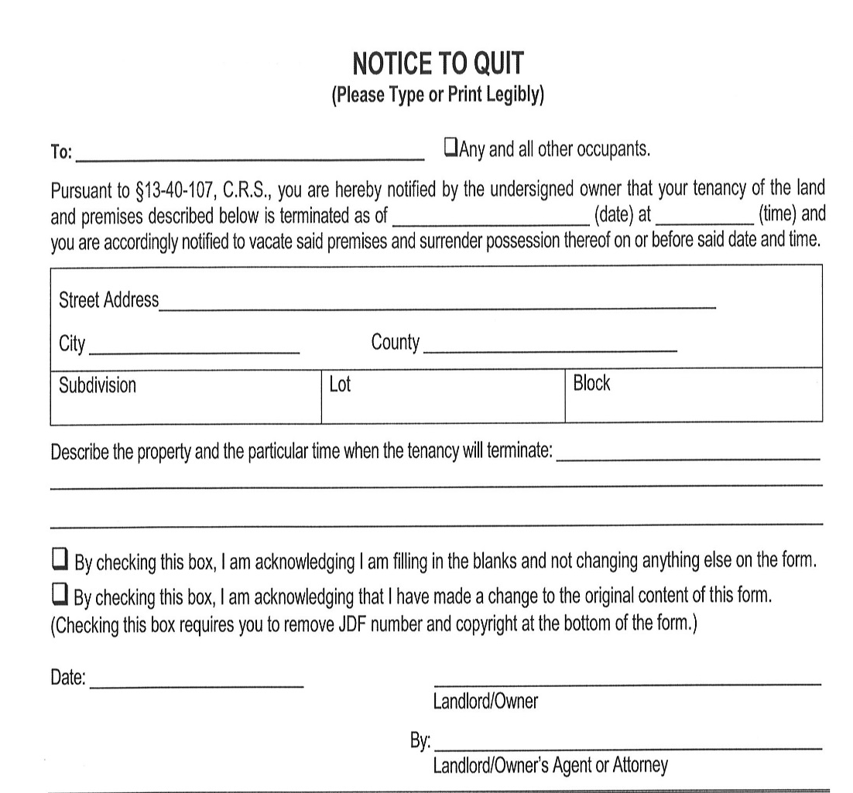
Notice to Quit

Slide 28
Steps in Giving Notice:
1) Service of Notice—Notice must be hand delivered to tenant or posted in conspicuous place on property.
Note: Not required to use sheriff/process server, but recommended you have a neutral party deliver notice.
2) Wait notice period—Starts on day after notice posted and cannot end on a Saturday, Sunday or holiday (will run to next business day).
3)a. Tenant gets out or complies—end of process.
OR
3)b. Tenant does not leave property—start an FED (eviction) case with the court.

Slide 29
Starting a Court Case:
Who can bring the case
The action must be filed by a “person in interest”, i.e. the property owner or other individual or entity identified as the landlord or lessor on the lease. If you are the property manager or the individual or entity acting as an agent for the owner(s), you may be required to show proof of your authority to the Court.
NOTE: The general rule is that corporations and other entities must be represented by an attorney in court cases—C.R.S. § 13-93-101
  There is an exception for “closely-held entities” with no more than 3 owners—C.R.S. §13-1-127

Slide 30
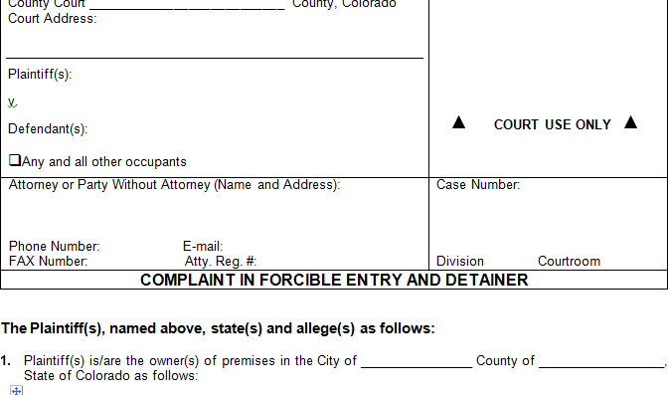
What is needed to start a court case?
Complaint (Form JDF 99)
  Attach copy of written lease, if any
  Attach copy of Notice served on tenant
Summons (Form CRCCP 1A)
  If you are not represented by an attorney, complete the top portion only and clerk will fill in the rest when you file. The Summons must include resource list (provided by and updated by the Department of Local Affairs).
  The clerk will give you a hearing date that should be between 7 and 14 days from the day you file
Answer (Form CRCCP 3), Request for Documents (Form 185 SC), Fee Waiver (Forms 205 and 206) and Resource List (Form 186 SC).
  Leave these blank and include with the documents served on the tenant.
Filing fee
  County Court if Less than $1,000 Filing Fee $85
  County Court if $1,000 up to $15,000 Filing Fee $105
  County Court if $15,000 up to $25,000 Filing Fee $135
  District Court is anything above $25,000 Filing Fee $224

Slide 31
Service of Summons and Complaint
The tenant must be served with the Summons and Complaint by someone who is over 18 and not related to your case (e.g. a process server or law enforcement)
  Whoever serves the tenant should complete an affidavit of service (form JDF 98)
The tenant must be served no later than 7 days before the hearing date
Service should be accomplished by handing the papers directly to the tenant or a member of his family over 18, if possible. If not possible, service can be accomplished by posting the papers in a conspicuous location on the property and mailing a copy to the tenant
  Note: If service is accomplished by posting and mailing, rather than personal service, the court can enter an order regarding possession of the property, but will not be able to enter a money judgment for back rent, damages, etc.

Slide 32

Tenant may file an Answer to the Complaint on or before the court date
Possible defenses may include:
  Did not receive/inadequate notice or improper service of notice*
  Improper service of Summons and Complaint*
  Tenant paid rent or cured violation within the Notice period
  Tenant tried to pay rent within the notice period, but landlord refused payment
  Landlord agreed to accept late rent payment or accept work in trade for rent
DO NOT IGNORE A TENANT’S ANSWER
Answer may contain defense to your Complaint you will need to address in court
Answer may contain a counterclaim against you
*defense must be raised in answer, cannot be raised for 1st time at trial

Slide 33
Possible Defenses:
Continued
Landlord accepted rent after lease violation occurred and/or notice given
No lease violation or failure to pay rent occurred
Eviction for substantial violation—actions do not meet requirements of “substantial violation”
Eviction for substantial violation—victim of domestic violence
Person responsible for lease violation or substantial violation not tenant or guest/invitee of tenant and no way tenant could have known in advance person would commit the acts
Tenant able to pay the landlord rent owed before the judge orders possession for the landlord.
Tenant used rent money to repair premises and deducted cost from rent after giving notice to landlord of repairs needed and landlord fails to make repairs
Tenant physically or mentally disabled and unable to pay rent due to disability
Landlord evicting tenant in retaliation for tenant making report to government about landlord or property
Eviction due to unlawful discrimination

Slide 34

Before the court date
*Note: The court date on the summons is a deadline for the tenant to file an Answer. If the tenant files an Answer, a trial date will be set between 7 and 10 days later (C.R.S. 13-40-113(4)(a))
You may be required to participate in mediation prior to your court date
  If you and the tenant come to an agreement, you can file a Stipulation (written agreement signed by both of you) with the court and ask to vacate the hearing.
Prepare for your court appearance.
  You are responsible for getting any evidence you want to present to the court—this means arranging for any witnesses to be available to testify and having 3 copies of any documents, pictures, or other evidence with you when
you come to court

Slide 35
Court trial
  As the Plaintiff, you will have the burden of proof, so it will be your job to prove what you are claiming
    Includes proving damages—do you have before and after pictures? Checklists?
Both sides will have the opportunity to give testimony, have witnesses testify, and present evidence to the court
The judge and the other party will be able to ask you (if you testify) and any of your witnesses questions
You will be able to ask questions of the tenant (if he/she testifies) and any of the tenant’s witnesses
  Make sure to actually ask questions, and not argue or talk over the tenant/witness
  Remember to be organized, prepared, and respectful at all times

Slide 36

After trial—if you win
Order for Possession
Money Judgment
Judge orders possession of the property returned to you and gives the tenant time, not less than 48 hours, to leave
After 48 hours, you can ask the court to issue a Writ of Restitution (form JDF 103)
The Writ of Restitution directs the Sheriff to assist you in forcibly removing the tenant from the property. The Sheriff cannot “execute the writ” (remove the tenant) until at least 10 days have passed since judgment was entered.
Judge enters a judgment in your favor for back rent, damages, etc.
May be an additional hearing on damages after possession returned to landlord
Court costs usually awarded to prevailing party—whether attorney fees awarded depends on terms of your lease agreement
Can collect like any other money judgment, but it is your responsibility—the court does not do this for you
For more information see Form JDF 82 on the Courts website

Slide 37

Removing the tenant and belongings from property
If the court issues a Writ of Restitution, it will be your responsibility to make arrangements with the Sheriff’s office to go execute the Writ
The Sheriff’s office will supervise, but likely will not participate in physically removing any of tenant’s belongings from property—it will be your responsibility to make arrangements to have someone physically move the belongings
If you (or someone under your direction) are physically moving the belongings, you can legally move them as far as the street and you have no further obligation—if you undertake to store the possessions, you may be taking on additional obligations/liabilities
Abandoned property—See C.R.S. § 38-20-116 or consult an attorney

Slide 38
After a Tenant Leaves
Landlord must return tenant’s security deposit and/or give itemized accounting
Landlord has 30 days to do this, unless longer stated in the lease, but no more than 60 days
THIS REQUIREMENT CANNOT BE WAIVED THROUGH THE LEASE
Return of security deposits
C.R.S. § 38-12-103

Slide 39
Return of Security Deposit
Landlord can retain all or a portion for the deposit only for:
  Unpaid rent;
  Unpaid utilities (if agreed that it was tenant’s responsibility to pay);
  Damage beyond “normal wear and tear”
“‘Normal wear and tear’” means that deterioration which occurs, based upon the use for which the rental unit is intended, without negligence, carelessness, accident, or abuse of the premises or equipment or chattels by the tenant or members of his household, or their invitees or guests.
  C.R.S. § 38-12-102(1)
Before and after checklists/pictures can be helpful in showing damages

Slide 40
Return of Security Deposit
If you fail to timely return deposit/provide accounting and fail to respond to a demand letter from tenant, you forfeit the right to retain any of the security deposit for damages and may end up owing the tenant triple the amount of the security deposit plus attorney fees.
See C.R.S. § 38-12-103(2), (3)

Slide 41
Statute of Limitations:
Court actions to recover security deposit
Treble Damages
Security Deposit & Attorney Fees
Tenant must bring a court action within 1 year in order to recover the treble damages.
Tenant can still recover security deposit and attorney fees as long as he/she brings a court action within 6 years.
Carlson v. McCoy, 566 P.2d 1073 (Colo. 1977).

Slide 42

Special Thanks!
This Photo by Unknown Author is licensed under CC BY-ND
- Century Property Management and Sales, LLC
- La Puente, Inc.

