Slide 1
Initial Status Conference
C.R.C.P. 16.2
By Family Court Facilitators
Eric Burton
Daphne Robinson
Nicolle Rugh
Michael Vigil
Cecilia Wall

Slide 2

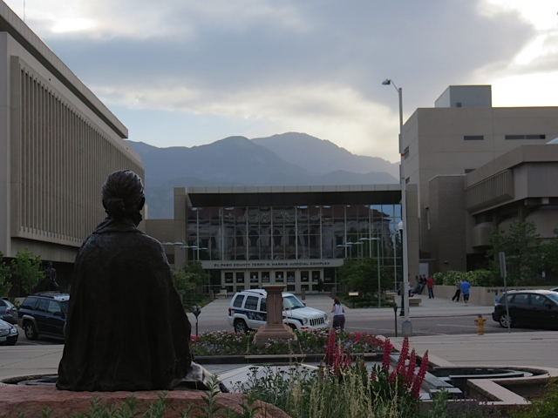
Why Are You Here?
You are here to complete your court ordered Initial Status Conference.
All Dissolution of Marriage, Dissolution of Civil Union, Legal Separation, Allocation of Parental Responsibilities, Invalidity of Marriage & Invalidity of Civil Union cases must complete an Initial Status Conference within 42 days of the filing of the case.

Slide 3

ISC Overview &
Case Management Order
Order and Notice of ISC
  Case Management Order (FCF 400).
  Both are orders of the court signed by a judge.
  Parties are required to comply with both orders.
Your case will be set for an internal review about 45 days out from today’s date. This is for the court to check the status of your case and see if you have complied with the orders.
Your case can be delayed or dismissed if you do not comply with the orders.
Temporary Orders Hearing – Can be requested by either party. This is a hearing where orders can be put in place until your Final Orders Hearing.

Slide 4


After the ISC you will receive:
An Initial Status Conference Order that outlines specific due dates for your case. (Sent through regular mail or e-filing)
An email w/forms required to complete your case and procedural instructions to move case forward
FCF contact information – Email is Best!

Slide 5


Meaningful Notice to
the Other Party/Service
Rule 4 of the Colorado Rules of Civil Procedure requires that meaningful notice be provided to the other party:
  Co-Petitioner Filing: Petition signed by both parties.
  Waiver & Acceptance of Service: Signed by the Respondent.
  Proof or Return of Service Form: Completed and signed by the server.
  Publication by Consolidated Notice: When the other party cannot be located for service.

Slide 6


Filing a Response & Fees
Once served, the Respondent has 21 days (if served in Colorado) or 35 days (if served out of Colorado) to file a Response to the Petition.
The Response to the Petition lets the court and the other party know what you are objecting to and what orders you are asking for.
Filing Fee: $146 is charged to the Respondent on first responsive pleading.
Fee waiver/payment plan available upon approval.

Slide 7

Sworn Financial Statement
& Financial Disclosures
Each party is REQUIRED to file their own Sworn Financial Statement (JDF 1111 and Supporting Schedule JDF 1111SS). This form must include a FULL disclosure of your current financial situation – no matter what your agreements are.
Each party must also comply with the Mandatory Disclosures (16.2) by completing the exchange of financial documentation with each other and filing the Certificate of Compliance (JDF 1104) with the court.

Slide 8
Waiving Disclosures (JDF 1372)
File complete JDF 1111
Not requesting maintenance
Not pregnant/no minor children and neither supports a minor
Marital assets below $100,000
No pension/trust, separate property interests exceeding $10,000
Combined debt minus mortgage is less than $50,000
ALL MUST APPLY!!

Slide 9
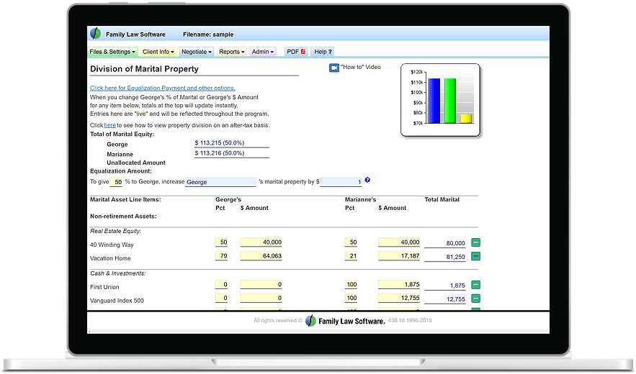

Spousal/Partner Support
Advisement (FCF 425)
A copy of the Spousal Support Advisement will be attached to your ISC Order and emailed to you. Please sign, date, and file with court (even if not requesting it) to acknowledge you received a copy.
It is up to the parties to READ and CALCULATE the guideline amount as directed.
This is ONLY a GUIDELINE as to support amounts and length of payments.
Download the free Family Law Software to assist with calculations. (Optional for maintenance, but encouraged)

Slide 10






Property and Financial Agreement
(JDF 1115)
In Dissolution of Marriage or Civil Union, Legal Separation, or Invalidity of Marriage cases, a Property and Financial Agreement (JDF 1115) is required, telling the court how your things will be divided. This form will become a court order, and enforceable once your decree is entered.
If you have a full agreement, you file the form with BOTH of your non electronic signatures, if you do not have a full agreement, you each prepare your own with how you want things to go.

Slide 11

Parenting Plan (JDF 1113) &
Child Support Worksheet
A Parenting Plan (Form JDF 1113) tells the court how you and the other party will parent your child(ren) (regular parenting time, holiday parenting time, decision-making, etc.), and how you will financially support them.
If you and the other party agree on all issues, you file a Parenting Plan in your case with BOTH non electronic signatures. This form will become a court order, and enforceable once your case is completed.
If you and the other party do not agree on issues, you prepare your own Parenting Plan letting the court know how you want it to decide all issues regarding your child(ren).
The Child Support Worksheet is required for ALL cases involving children under the age of 19 – unless there is already an existing child support order from the court.
Download the free Family Law Software to complete the worksheet. (MANDATORY for child support)

Slide 12

Required Level 1
Parenting Class
Must be completed by all parties involved in a case involving children under the age of 18.
Go to: Fourth Judicial Parenting Class List 06 2025
Classes will require a fee (some may have fee waiver options)
Once class is complete, make sure to file your certificate of completion with the court.

Slide 13

Mediation Requirement
Mediation is an intervention by a trained neutral third party with the purpose of assisting two or more individuals to reach their own solutions.
Mediation is MANDATORY in your case when you do not have a full agreement on ALL issues. If you and the other party have disputed issues and you do not complete mediation, your case may be delayed or dismissed.
Parties are encouraged to set mediation as soon as possible. You do not have to reach an agreement at mediation. Any issues not resolved will be decided by the judge at your contested hearing.
You may use the Office of Dispute Resolution (ODR). ODR charges $150 per person, unless your income qualifies you for a fee reduction (JDF 211). Mediation fees must be paid directly to the mediator at least 10 days prior to your scheduled date. Mediation can also be done privately – they would set their own schedule and fees.
ODR Mediation is virtual, but please let your Family Court Facilitator know if you have safety concerns or issues related to domestic violence and do not feel it is appropriate for your case. You can file to ask the court to waive the requirement. (JDF 1307 and 1308)
Questions regarding Mediation:
www.coloradojudicial.gov/court-services/office-dispute-resolution

Slide 14
Another Mediation Option:
ENA is Entirely Child Focused
The goal of ENA is to move families through court as quickly, fairly and inexpensively as possible. Early agreements tend to benefit the children. If parties come to an agreement during the session, they can see their judge on the same day. Most cases come to a full agreement during the ENA session and receive temporary orders and/or complete their case that day. Statutory requirements (waiting period) still apply.
Our 4th Judicial ENA Team consists of 2 child and family experts (a licensed clinical social worker, an attorney) and YOU.
ENA is a great alternative for cases where both parents have the child’s best interest at heart but have not yet come to an agreement regarding parenting time and decision making.
ENA is not a good fit for cases with disputed issues regarding property and finances. It is not for parties with safety concerns.
If you are interested, your Family Court Facilitator will refer you to the ENA team to discuss screening, scheduling and payment/waiver of fees.

Slide 15
Mediators
DO
DO NOT
Do help parties work together to come to their own agreements.
Do provide neutral, impartial, professional, and confidential services.
Do not represent either party, provide legal advice, or make decisions about the outcome of your case.
Do not assist you with completing any forms that you need to file for your case.

Slide 16

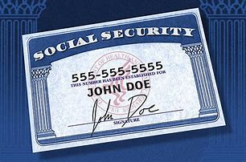
Change of Contact Info
and
Social Security Numbers Required
It is your responsibility to notify the court of any change of contact info.
Your contact information
can be changed by filing the
Contact Info Change form (JDF 1312)
Social Security #’s are needed to enter support orders and are kept access restricted to the public. (JDF 1000)

Slide 17

Court Care
(El Paso County)
Children are not allowed in ANY court proceeding. FREE childcare is provided (based upon availability and health of the child) through Court Care for children ages 6 weeks to 14 years old. Located in room S140.

Slide 18

How to file Paperwork
EL PASO COUNTY
Hand Delivery: Room S-101 open M-F from 7:30am to 4:30pm. Bring your original + 2 copies (single sided documents only).
Mailing to the Courthouse: Requires the Original + 2 copies of each document (single sided documents only). Include 2 self-addressed stamped envelopes (one addressed to each party). The court will keep the original, date stamp and send back the copies for your proof of filing.
Address: El Paso County Judicial Building
Attn: Room S-101
270 S. Tejon St.
Colorado Springs, CO 80903

Slide 19
How to file Paperwork
TELLER COUNTY
Hand Delivery: Open M-F from 8:00am to 4:00pm. Bring your original + 2 copies (single sided documents only).
Mailing to the Courthouse: Requires the Original + 2 copies (single sided documents only). Include 2 self-addressed stamped envelopes (one addressed to each party). The court will keep the original, date stamp and mail back the copies for proof of filing.
Address: Teller County Courthouse
101 W. Bennett Ave.
P.O. Box 997
Cripple Creek, CO 80813

Slide 20

Pro Se E-Filing
One-time opt-in fee of $12.00
  This creates a Colorado Courts E-Filing (CCE) account.
  Once your account is created, you can check the status of your case online and view filings.
Per Submission Fee - $12.00
  This is charged each time you file. You can file multiple forms under one submission.
  There are additional fees for mailing forms to the other side, etc.
None of the fees are refundable.
No fee waivers for electronic filings. For more information, visit:
https://www.coloradojudicial.gov/e-filing-non-attorneys

Slide 21

Additional Assistance
Email is the best way to reach me going forward. Please allow at least 48 business hours before sending follow up/duplicate email
PLEASE just “reply” back to original email I send and all future emails if possible! This will help get a quicker response from time saved looking up case number and what was discussed previously (1000+ emails a month) – daphne.robinson@judicial.state.co.us
You may also contact our office at 719.452.5104 to schedule a 15-minute phone appointment during the FCF Access Hours.

