Slide 1


Slide 2

The Colorado Commission on Criminal and Juvenile Justice
is a multidisciplinary 30-member entity that was established in 2007 by C.R.S. 16-11.3-101 to improve “the effective administration of justice” by undertaking a comprehensive examination of the criminal and juvenile justice systems and making recommendations for reform.
***
The mission of the Commission is to enhance public safety, to ensure justice, and to ensure protection of the rights of victims through the cost-effective use of public resources. The work of the commission will focus on evidence-based recidivism reduction initiatives and the cost-effective expenditure of limited criminal justice funds.
August 2018

Slide 3
Stan Hilkey, Commission Chair Executive Director, Department of Public Safety
Chris Bachmeyer, Chief Judge, 1st Judicial District Jennifer Bradford, Department of Higher Education John Cooke, State Senator, Senate District 13 Cindy Cotten, Juvenile Justice Representative, CYDC Coordinator, 19th Judicial District Shawn Day, Presiding Judge, City of Aurora Valarie Finks, Victim Representative, 18th Judicial District Tony Gherardini, Department of Human Services Kristen Hilkey, State Board of Parole Nancy Jackson, Arapahoe County Commissioner Jessica Jones, At-large, Law Office of Jessica Jones Daniel Kagan, State Senator, Senate District26 Bill Kilpatrick, Golden Police Chief Richard Kornfeld, Criminal Defense Attorney, Recht Kornfeld, P.C. | Cynthia Kowert, Deputy Attorney General Andrew Matson, Former Offender, Billtrust Joseph Pelle, Boulder County Sheriff Rick Raemisch, Executive Director, Department of Corrections Tom Raynes, Colorado District Attorneys’ Council Megan Ring, State Public Defender Rose Rodriguez, At Large, Independence House Cliff Riedel, District Attorney, 8th Judicial District Joe Salazar, State Representative, House District 31 Lang Sias, State Representative, House District 27 Jenny Stith, Victim/Survivor, Wings Foundation Glenn Tapia, Director of Probation Services Anne Tapp, Victim Advocate, Safehouse Progressive Alliance for Nonviolence Abigail Tucker, Community Reach Center Meg Williams, Juvenile Parole Board Joe Thome, ex-officio, Director, Division of Criminal Justice
August 2018

Slide 4
Previous Task Forces and Subcommittees
Bail Subcommittee
Community Corrections Task Force
Cost Savings Subcommittee
Direct File Subcommittee
Drug Policy Task Force
Juvenile Justice Task Force
Re-Entry Oversight Committee
Behavioral Health Task Force
Cyber-bullying Committee
Re-entry Task Force
Juvenile Continuity of Care Task Force
First-Responder Study Group
MOR Committee
Mandatory Parole Committee
Probation Task Force
Incarceration Task Force
Transition Task Force
Post-Incarceration Supervision Task Force
Sentencing Task Force
Sex Offense/Offender Task Force
Human Trafficking Working Group
Jessica’s Law Working Group
August 2018

Slide 5
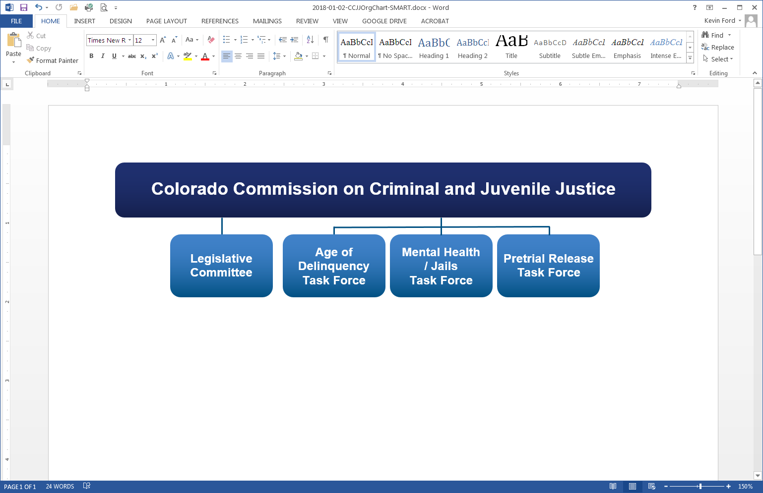
Current Task Forces & Committees
August 2018

Slide 6
Pretrial Release Task Force
The Task Force was established in July 2017 and was charged with examining existing pretrial practices including: the use of a risk assessment tool, communication between key partners, and matters concerning the implementation of the
2013 statute.
  Task Force Membership
Stan Hilkey, Dept. of Public Safety / Chair | Greg Mauro, Denver Community Corrections
Judge Chris Bachmeyer, 1st Judicial District | Lucienne Ohanian, Public Defender’s Office
Jennifer Bradford, Metro State University of Denver | Clifford Riedel, Larimer County District Attorney
Maureen Cain, Criminal Defense Attorney | Monica Rotner, Boulder County Community Justice Services
Steve Chin, Mesa County Pretrial Services | Glenn Tapia, Judicial, Probation Services
Judge Shawn Day, Aurora Municipal Court | Kirk Taylor, Pueblo County Sheriff
Valarie Finks, Victim Services, 18th Judicial District | Joe Salazar, Representative, House District 31
Bill Kilpatrick, Golden Police Department | Lang Sias, Representative, House District 27
Mindy Masias, State Court Administrator’s Offices | Bo Zeerip, District Attorney 21st Judicial District
August 2018

Slide 7
Pretrial Release Task Force
Review of data and information:
  The Task Force engaged in an extensive analysis of Colorado data and information concerning the use of personal recognizance bonds, the existence of pretrial services, and the use of the CPAT risk assessment tool.
  The Task Force also examined work taking place in other jurisdictions concerning bail/bond reform.
August 2018

Slide 8
Pretrial Release Task Force
Conclusions:
  While many counties use a CPAT risk tool and have pretrial service agencies, many still do not (37 counties have no pretrial service or risk assessment).
  After passage of the 2013 legislation, several counties expanded the use of personal recognizance bonds rather than requiring the posting of cash bonds or surety.
    The use of PR bonds (as an alternative to cash/property/ surety bonds) increased from 18% to 31% in District Court cases and from 26% to 46% in County Court cases, between 2013-2016.
  Several jurisdictions (NM, NJ, DC, DE) were revising their approach to bail/bond decision making and reducing or eliminating cash bonds.
April 2018
Notes:
REFER TO THE FIRST HANDOUT IN THEIR PACKETS SHOWING THAT COUNTIES THAT DO AND DO NOT HAVE PRETRIAL SERVICES

Slide 9
Pretrial Release Task Force
The Task Force identified three areas of focus:
  Developing recommendations regarding the use of pretrial services and risk assessment tools on a statewide basis
  Exploring the possible development of a pretrial detention approach which could reduce the reliance on cash bonds
  Examining opportunities to improve implementation of 2013 statutory changes
April 2018

Slide 10
Pretrial Release Task Force
The Task Force has approved three recommendations regarding pretrial services and risk assessment tools:
  Require the use of pretrial risk assessment tools in all Colorado Counties.
  Implement training standards for the administration of pretrial risk assessment tools and create an inventory of approved pretrial assessments
  Establish pretrial programs statewide and create a state administered grant program to support development efforts in jurisdictions without current pretrial programs
April 2018
Notes:
COPIES OF THE THREE RECOMMENDATIONS ARE IN THEIR PACKETS

Slide 11
Pretrial Release Task Force
The Task Force is also examining possible legislative and Constitutional modifications that would:
  Prohibit a defendant from being detained due to an inability to pay a financial condition of bond.
  Promote the pretrial release of the majority of pretrial defendants without any monetary conditions of release.
  Allow judicial officers to detain a limited number of defendants who are found, after a due process detention hearing, to be a substantial risk to public safety, or to flee prosecution, or to obstruct the criminal justice process.
April 2018

Slide 12
Pretrial Release Task Force
The Task Force is exploring opportunities to promote the implementation of outcomes consistent with the 2013 pretrial release legislation. These include:
  Considering expedited jail release opportunities.
  Creating a priority docket for individuals in custody.
  Developing or expanding training for personnel involved in pretrial release activities.
  Improving or requiring certain data collection activities.
April 2018

Slide 13
Questions?
April 2018

