Slide 1
Divorce & Custody
Metro Volunteer Lawyers

Slide 2
Terminology
Petitioner = Person that Files the Case
Respondent = Person Responding to the Case (other party)
Dissolution of Marriage = Divorce (with or without children)
Allocation of Parental Responsibilities = Parenting Time Determination only (parties never married)

Slide 3
How to File Your Case
Petition
For Dissolution of Marriage → JDF 1011
For Allocation of Parental Responsibilities → JDF 1413
Case Information Sheet
For all cases → JDF 1000
Notes:
Either party may file for divorce or APR, or parties may file together (as co-petitioners). Important to note is that you do not need the other party’s permission or agreement to file for and be granted a divorce. So long as you believe the marriage is irretrievably broken, you can file for a divorce.

Slide 4
What to Expect After Filing Your Case

Slide 5
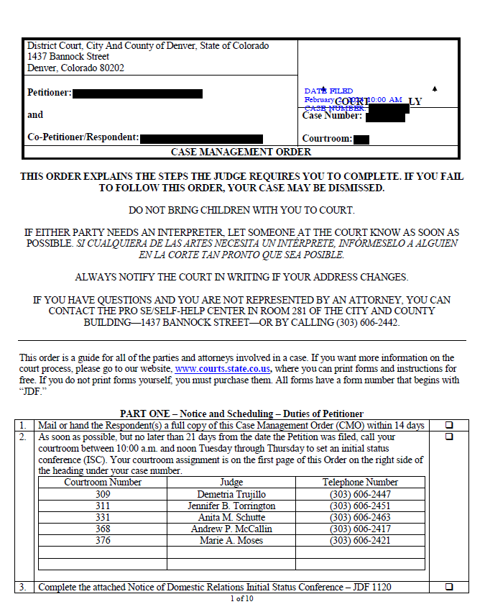
Case Management Orders
Notes:
After you file your case with the Court, the Court will issue a document called a Case Management Order. This is an extremely helpful and important document that will help you navigate each step you need to take throughout your case. So now let's talk about what is in the Case Management Order.

Slide 6
Service of Process
Filing Jointly
Waiver of Service – JDF 1013
Process Server/Sheriff’s Office
Service by Publication
Notes:
The first thing you need to work on will be service of process.
In most cases, the Court requires that the Petitioner (i.e., the party that filed the case) have the other party served with the initial court paperwork. Service of process formally notifies the other party that they have been named in the court case and as such have certain rights and responsibilities. There are a few different ways to satisfy the service of process requirement.
If parties file jointly (i.e., both parties sign the initial Petition) then the Court does not require Service of Process
The Petitioner can ask the other party of they will sign a Waiver of Service. If the party agrees, the Petitioner can file the Waiver of Service instead of completing service of process
Another common option is to use a process server to complete service of process. There are private process servers, but we often suggest contacting the Sheriff’s office where the other party lives to ask about using their office for service of Process. Make sure to ask the process server, whether private of the sheriff’s office, to provide you with a Return of Service that includes information about whether service was successful.
Finally, if you are unable to locate the other party after making significant to locate them, you can ask the Court for permission to complete service via publication. Be prepared that you are going to have to demonstrate to the court the specific attempts you have made to try and locate the other party.

Slide 7

Initial Status Conference
Notes:
Shortly after a case is filed, the Court will schedule an Initial Status Conference which both parties must attend. These are often held virtually, over the phone, so parties do not need to go to the courthouse. However, always check your CMO and/or you Notice of Initial Status Conference to determine whether you will call in or need to appear in person.
Th Initial Status Conference is often very brief (10-15 minutes) and is meant to make sure that the case is progressing and that both parties know what they need to do. The ISC is often held with a family court facilitator, instead of a judge. You can ask the family court facilitator questions about paperwork and deadlines, but the family court facilitator cannot give you legal advice. Parties should be prepared to update the Court about the status of service of process and the scheduling of mediation at the initial status conference.

Slide 8
Mandatory Financial Disclosures
Both parties must complete and share certain financial information with each other
Sworn Financial Statement – JDF 1111
Additional Mandatory Financial Disclosures – FORM 35.1
Certificate of Compliance with Mandatory Disclosures – JDF 1114
Notes:
In all cases, so both divorce and APR cases, parties are required to exchange proof of income and monthly expenses with each other. If the parties are married, so only in divorce cases, both parties must also exchange proof of assets, debts, and other accounts. Prior to the Initial Status Conference, both parties must file their own Sworn Financial Statement, which details out each party's income, expenses, and assets/debts/accounts when applicable.
Next, parties are also required to exchange additional proof of financial information. You can look up FORM 35.1 for a complete list of the required disclosures, but common disclosures include credit card and bank account statements, pay stubs, tax returns, and retirement plan information. These documents are only exchanged between the parties; parties do not file any of these documents with the Court. Instead, both parties must file a Certificate of Compliance with Mandatory Financial Disclosures. By signing and filing this document, each party is certifying to the Court that they exchanged the required financial disclosures with the other party.

Slide 9
Co-Parenting Class Requirement
In any case involving minor children (whether divorce or APR) both parties must take a co-parenting class and provide proof of completion to the Court.
Notes:
You will need to check your CMO for the specific courses that your court will accept.
Most courses offer an online version, but there are also in person option if that is something you prefer. Additionally, if you qualified for a fee waiver when you filed you case (as if you did not have to pay to file your case) it is possible you may also qualify for a waiver/reduced fee for the co-parenting class.
Finally, this class is not designed to teach you how to parent; the class is designed to teach you how to co-parent now that you will be raising your child(ren) separately.

Slide 10
Mediation Requirement
Mediation is a process in which a third party neutral works with both parties to try and come to an agreement. Parties are required to mediate prior to any final hearing.
Office of Dispute Resolution (ODR)
Private Mediators
Notes:
Mediators are often, but not always, lawyers. However, when they are acting in their capacity as a mediator, they are not allowed to give either party legal advice. Instead, the mediator’s job is to listen to what both parties are asking for and try to help the parties find a middle ground that they both agree on. Although mediation can be an extremely helpful and effective process, there is no consequence for the parties if they are unable to come to an agreement. Rather, the case will simply proceed to a contested hearing and a judge will make the final decision after hearing from both parties. Additionally, it is possible that parties may come to partial agreements (about certain issues) and proceed to hearing only on the remaining issues that the parties did not agree on.
The Office of Dispute Resolution offers more affordable mediation sessions and accepts fee waivers to qualify for a reduced fee. Parties may also choose to use a private mediator, for which costs can vary significantly.
When you finish the mediation, you should ask your mediator whether they will file a Certificate of Completion of Mediation with the Court or if you should file the Certificate. You will file this certificate whether or not you come to any agreements during mediation.

Slide 11

Preparing for a Hearing

Slide 12
Documents to File Before Your Hearing
Joint Trial Management Certificate/Pre-Trial Statement
Property & Financial Agreement – JDF 1115
Parenting Plan – JDF 1113
Child Support Worksheet
Spousal Support/Maintenance Advisement
Notes:
The CMO lists several documents that both parties must file before their final hearing.
The first document is a Joint Trial Management Certificate or a Pre-Trial Statement. If either or both parties has an attorney, parties will file a JTMC; if both parties are representing themselves each party should file their own Pre-Trial Statement. Whether you are working on a JTMC or a Pre-Trial Statement the goal of either document is to explain your position on each issue to the court. You should take time to detail what outcome you are asking for AND why you want what you are asking for.
In divorce cases both parties must a Property and Financial Agreement that details how each party is asking for any assets, debts, and accounts to be divided.
If there are minor children involved, whether in a divorce or APR case, each party must also file a Parenting Plan that details what each party is asking for regarding parenting time, decision making, and other issues concerning the minor children. Additionally, when there are minor children involved each party must also file a child support worksheet.
Finally, if the parties were married each party must also file a Spousal Support Advisement and/or worksheet.
These document typically must be filed 7 days before your hearing date, but always check your CMO to verify when the court has ordered you to file these documents.

Slide 13
Standards
Best Interest of the Child Factors
For all issues that concern minor children, the court is most concerned with ensuring that any decision is in the best interest of the children
C.R.S. 14-10-124
Equitable Division
The court will try to divide all marital property as equally as possible, but the law does not require a strict 50/50 division of marital property
Marital property includes any property (or debt) incurred by either party during the marriage regardless of whose name the property/debt is in
Notes:
There are two main standards to be aware of when preparing for a hearing. The first is the best interest of the child factors, which applies in any case involving minor children. The best interest factors guide the court in making any decision concerning the minor children. These factors include each party's ability to put the children’s needs above their own and provide a safe, loving environment for the children. Parties should present arguments demonstrating why what they are asking for is in the best interest of the child(ren) rather than better/worse for one of the parties.
The other standard to be aware of is equitable division of property, which only applies in divorce cases. Colorado law requires that courts divide all marital property equitably, not equally. This is a subtle distinction, but essentially it means that the courts must divide marital property as fairly as possibly, but they are not bound to a strict 50/50 division of marital property.

Slide 14
Metro Volunteer Lawyers
Family Law Court Program
Family Law Advice and Guidance
Mediation

Slide 15
Additional Resources
Colorado Legal Services
For domestic and family matters call 303-837-1313 between 9:00 a.m.–3 p.m., Monday, Tuesday, Thursday, and Friday (closed Wednesdays)
https://www.coloradolegalservices.org/
Licensed Lawyer
Search tool for low-bono/flexible legal representation options. Options may include flat fee agreements or sliding scale fee agreements
https://www.licensedlawyer.org/co
Project Safeguard
Provides assistance with civil protection orders for survivors of domestic violence
https://psghelps.org/

Slide 16
Questions?

